Slide 3
IF A TREE FALLS IN THE FOREST AND THERE’S NO ONE TO HEAR IT, DOES IT MAKE A SOUND?

Slide 4
I DON’T KNOW
WHAT I DON’T KNOW

Slide 5
FACEBOOK USERS
EARLY 2010 - 350 MILLION
END 2010 - 625 MILLION
EARLY 2012 - 800 + MILLION

Slide 6
“…..just did a run for fruits and veggies….”

Slide 7
ACCORDING TO STATISTA,
SMARTPHONE SALES
WILL REACH 1 BILLION IN 2016

Slide 8
SOCIAL NETWORKING PLATFORMS
FACEBOOK
TWITTER
PINTEREST
TUMBLER
INSTAGRAM
YOUTUBE

Slide 9
CIRCLE OF COMMERCE

Slide 10
“IN THE FUTURE, EVERYONE WILL BE WORLD FAMOUS FOR 15 MINUTES”
-ANDY WARHOL, 1968

Slide 11
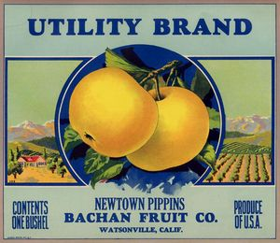
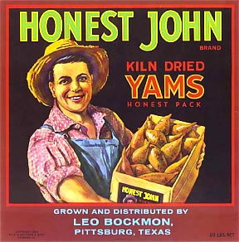
FRUITS, WEST HOLLYWOOD, CA

Slide 12
POSITIONING GOLD KIWIS

Slide 13
BC HOT HOUSE-MEET THE GROWERS

Slide 16
"Every time you open up two Chipotle restaurants, we add another naturally raised pig farmer into this farmers’ cooperative called Niman Ranch Pork Company. When we started, there were 50 to 60 of these farmers. Now there are between 600 and 700."
-MARK CRUMPACKER, CMO, CHIPOTLE

Slide 17
IMAGE OF A “NEW” BROOKLYN VEGGIE MARKET

Slide 18
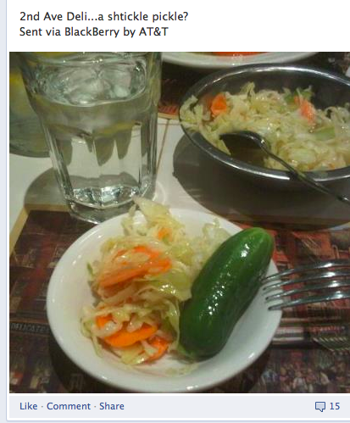
FACEBOOK FOOD POSTS

Slide 19
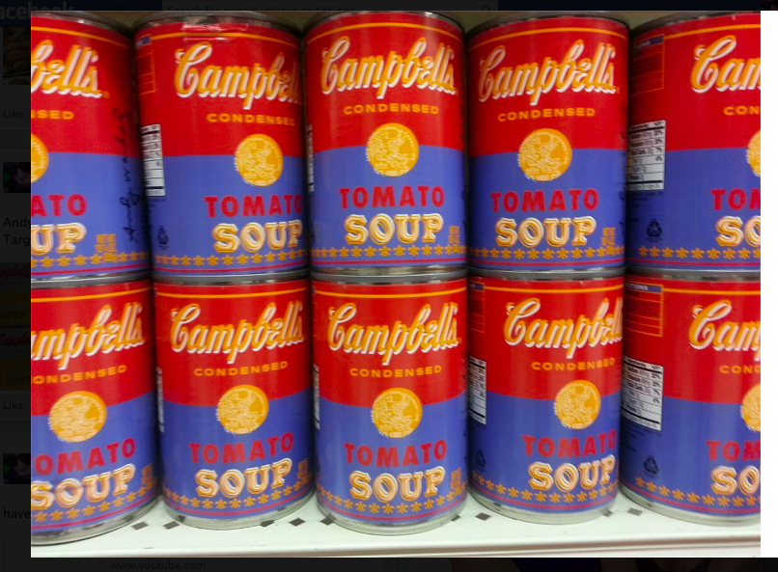
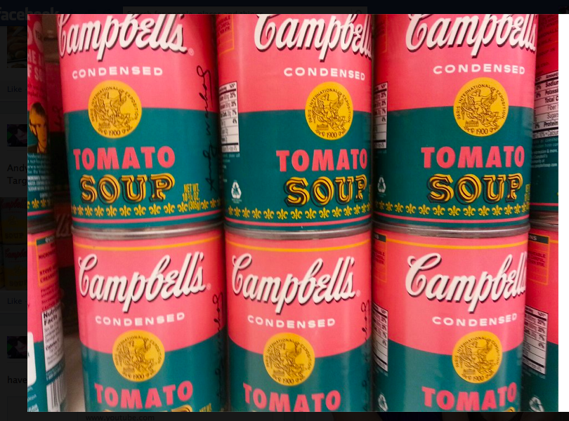
TARGET CELEBRATES 50TH ANNIVERSARY OF WARHOL’S CAMPBELL’S SOUP

Slide 20
NEIMAN MARCUS/
TARGET
COLLABORATION

Slide 21
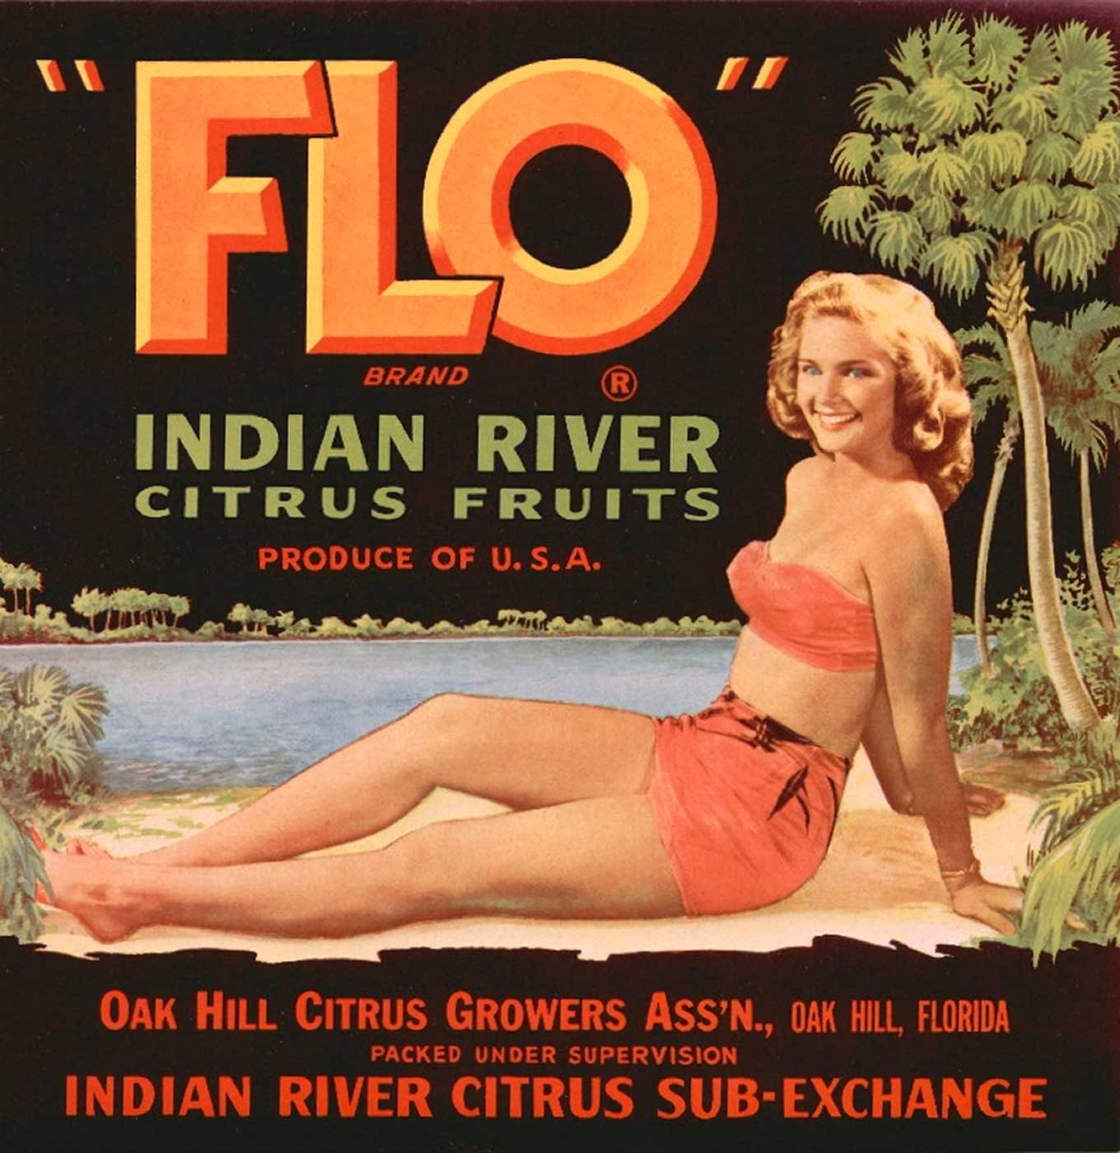

Slide 22
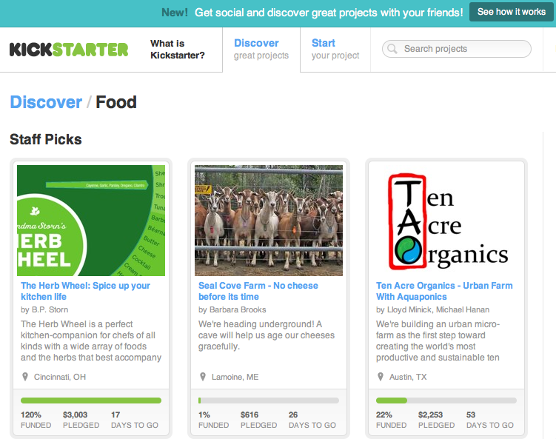
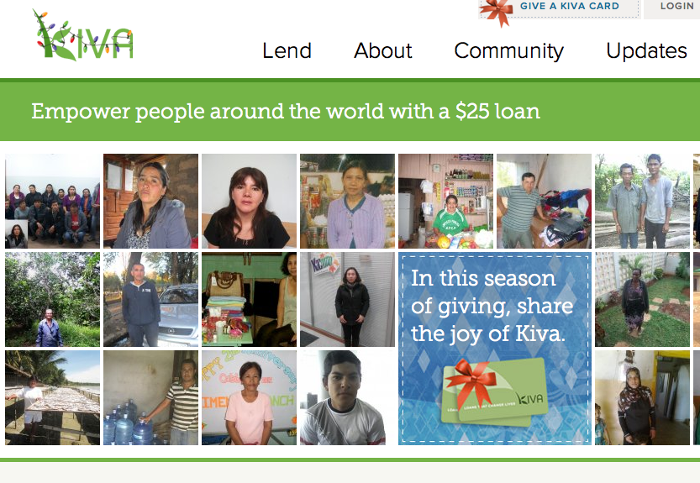

Slide 23
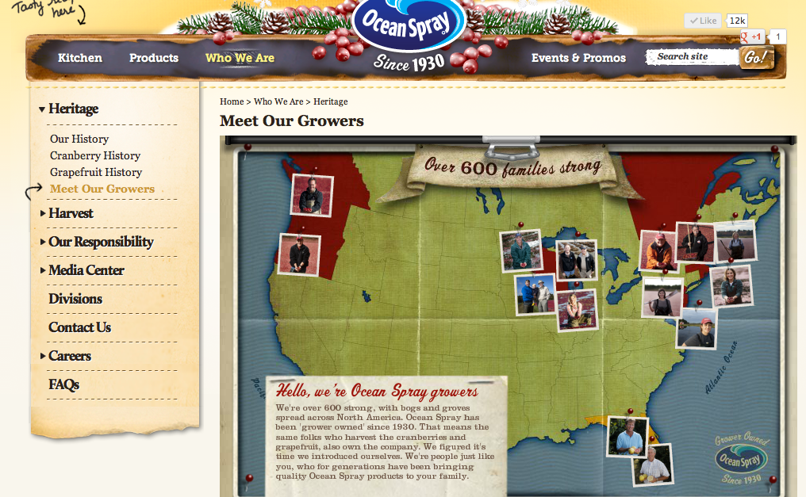

Slide 24
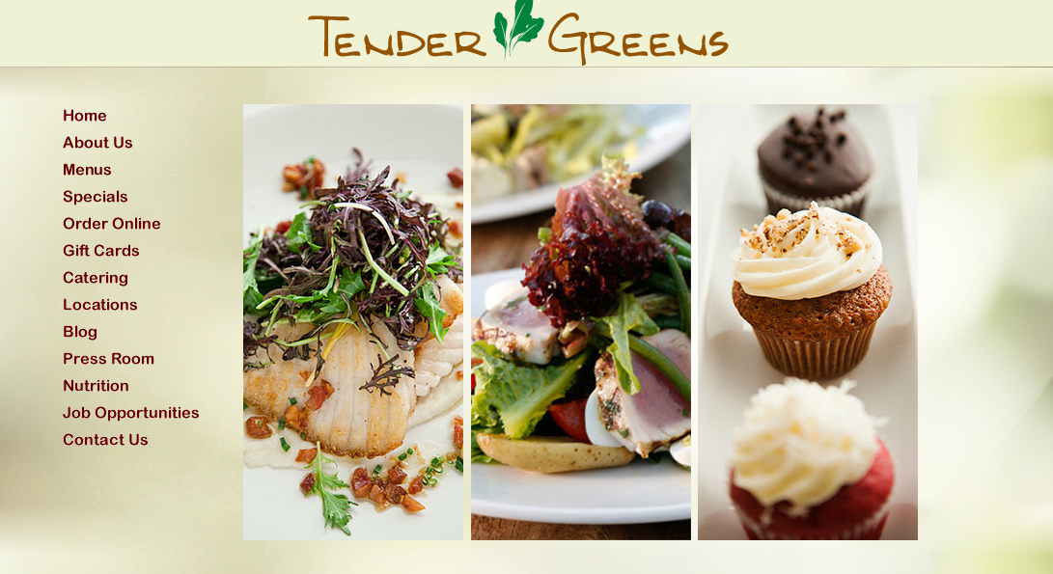

Slide 25
REMEMBER-
“IF YOU GROW IT, AND TWEET ABOUT IT, THEY WILL COME, THEY WILL EAT, AND IT WILL BE TASTY!”

