Slide 1
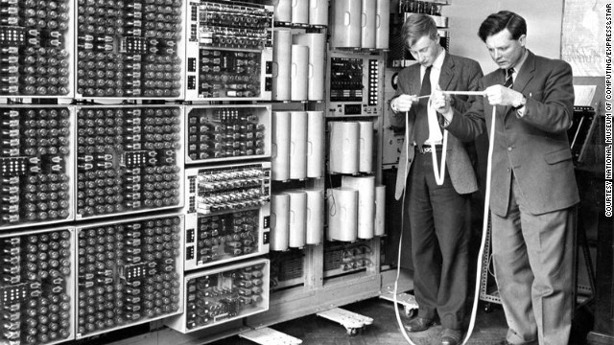
WOULD YOU INVEST IN YOU?

