Slide 1
CROWD SOURCING
YOUR SHOPPING
MARKETING
CONTENT
© 2013 John Courtney | Content Strategy Proprietary & Confidential

Slide 2
Addressing your retail shelf used to be easier…
© 2013 John Courtney | Content Strategy Proprietary & Confidential

Slide 3
Search
Mobile
Retail
Need
Ad
Social
Purchase
Brand Site
© 2013 John Courtney | Content Strategy Proprietary & Confidential
Notes:
17 years later, Google published “Zero Moment of Truth” to describe the new impact on consumers at retail. The explosion of reaching the ‘click to buy’ moment is dizzying. Today’s shopper bounces back and forth at their own speed in a multi-channel marketplace. They can switch devices to suit their needs at any given moment. They search; go off to look at reviews, ratings, styles and prices; and then search again. They see ads on TV and in newspapers and online. They walk to local stores to look at products. They talk to friends, over the back fence and on social media.

Slide 4
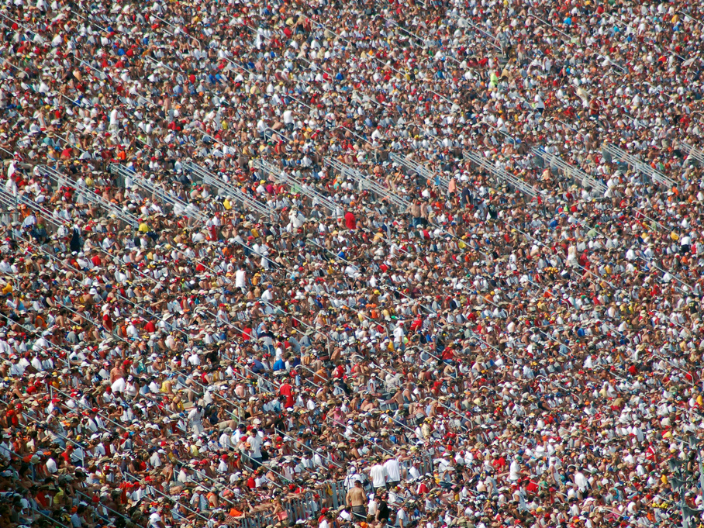
1 in 4 consumers post about you or to you
© 2013 John Courtney | Content Strategy Proprietary Confidential

Slide 5
CAPTURING VALUABLE CONTENT
…WHEREVER THEY ARE.
© 2013 John Courtney | Content Strategy Proprietary & Confidential

Slide 6
Leveraging User Generated & Professional Content
A platform built on years of social video experience
Relevant, informative, persuasive video content on product-page level
Sears has partnered with EXPO for past three years to build a library of over 33,000 user generated videos for Sears & Kmart products generated from social/communities such as Facebook, YouTube and Mobile
Drawing on EXPO’s 8 years of video community management with over 150,000 consumers, and a platform managing 350,000 product videos, Sears continues to add new user generated videos everyday
EXPO’s best-in-class online video platform powers all professional and user generated video supporting millions of SKUs and hundreds of merchants
EXPO adheres to legal and corporate best practices including moderation standards, consumer response needs and performance requirements.
© 2013 John Courtney | Content Strategy Proprietary & Confidential

Slide 7
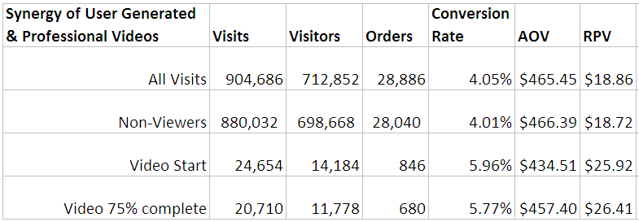
Critical Question
How does crowdsourced user-generated videos offer value?
© 2013 John Courtney | Content Strategy Proprietary & Confidential

Slide 8
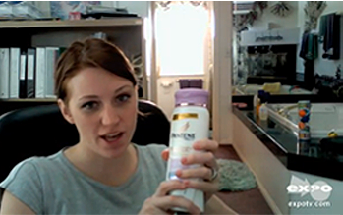
Crowdsourcing User-Generated Product Videos
Consumers persuaded by Professional video
Consumers persuaded by User video
User-Gen Reviews
Competitive Comparison
Product Quality
Product Convenience
New Feature Information
Professional Video
Emotional Elements
Brand Differences
Superiority Claims
2.7% Overlap
comScore April 2012 study comparing “Lift in Share” sourced by professionally produced video and user product review.
© 2013 John Courtney | Content Strategy Proprietary & Confidential

Slide 9
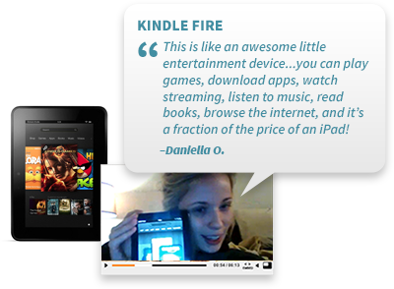
CROWDSOURCING :
IT’S TOUGH, BUT IT CAN BE DONE
3,000:1
Ratio of
Text vs. Video
© 2013 John Courtney | Content Strategy Proprietary & Confidential

Slide 10
CROWDSOURCING:
ACTIVATING COMMUNITIES TO CONTRIBUTE
There are a few important, yet overlooked steps when looking to generate quality video content from consumers:
Target the right consumers
Provide proper incentives
Model desired behavior
Give instructions
© 2013 John Courtney | Content Strategy Proprietary & Confidential

Slide 11
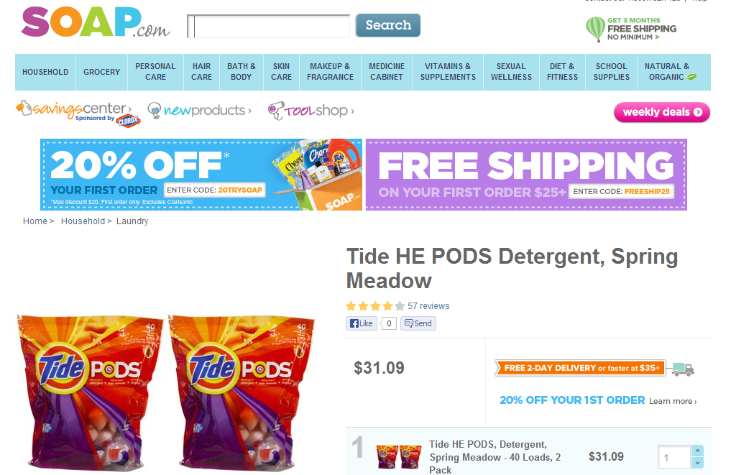
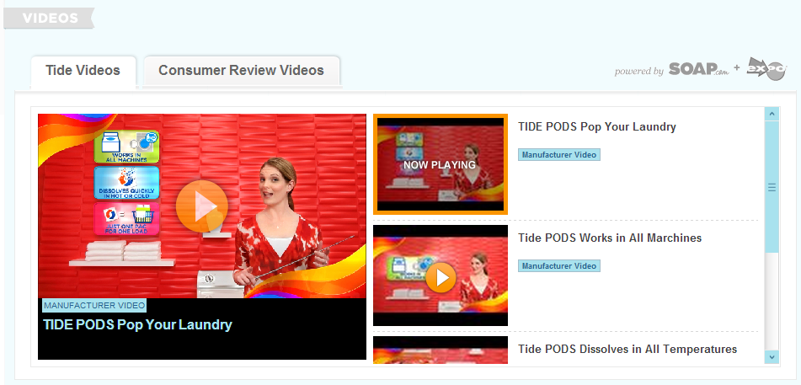
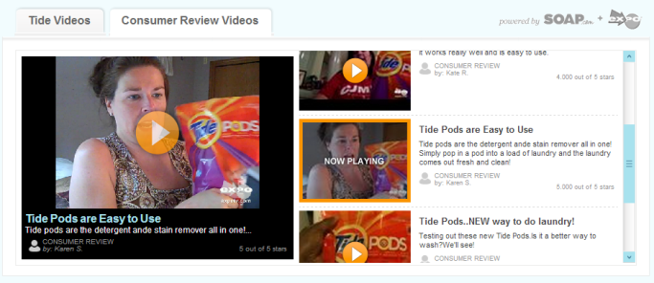
Best Practice: Pairing EXPO Video with professional video
A mix of EXPO video with professional video will reach the largest number of consumers with persuasive messaging.
Results:
EXPO video influences a distinctly separate consumer than professional videos (comScore)
Consumers will choose to watch EXPO videos 2-to-1 over professional videos when given a choice (internal EXPO)
80%+ retail consumers find EXPO videos easy to related to and believable (comScore)
© 2013 John Courtney | Content Strategy Proprietary & Confidential

Slide 12
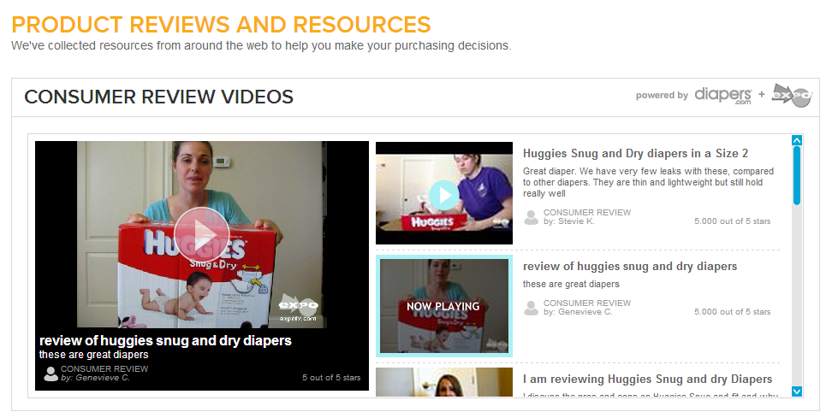
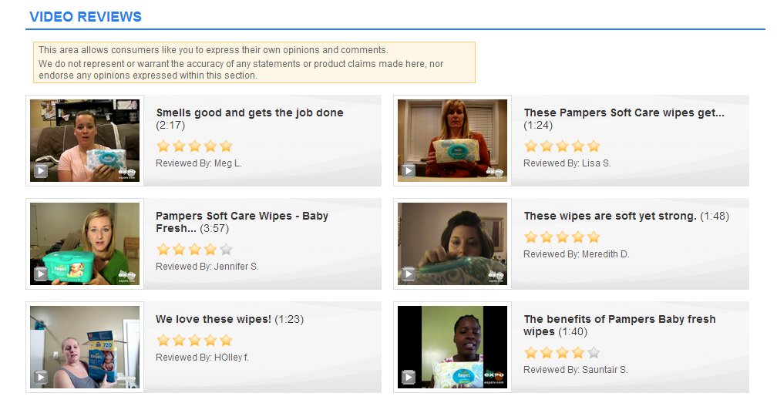
Best Practice: Availability of EXPO video on Product Pages
Present multiple thumbnails in-line on product pages so visitors can quickly identify with “someone like me”
Scrolling
Fixed Display
“Gallery”
comScore A/B Test:
+13% higher desire to pay more for a product
+26% higher belief that the product is unique and different
Example 1: diapers.com
© 2013 John Courtney | Content Strategy Proprietary & Confidential

Slide 13
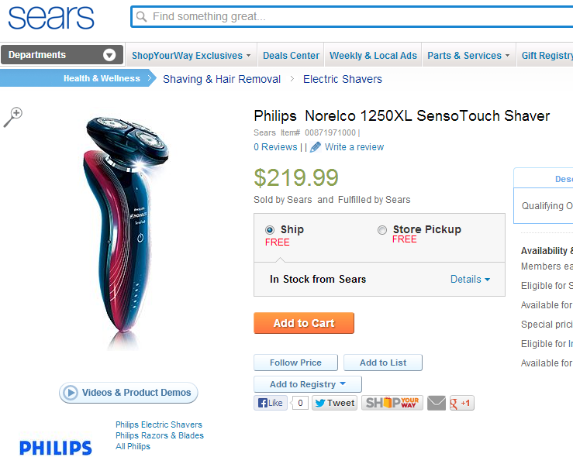
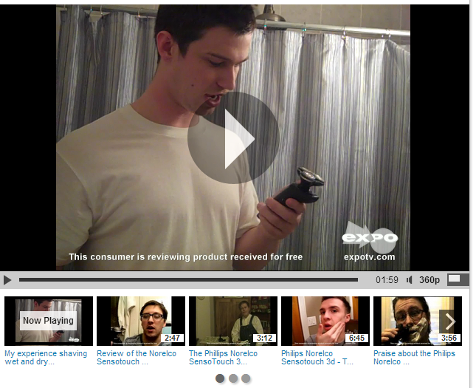
Impact of EXPO Video Viewership on Retail Websites
EXPO video widget integrated onto product pages of major national brick and mortar retailer websites
Results:
5.1x higher conversion of visitors who watched EXPO video
66% higher cart size for visitors who watched EXPO video
© 2013 John Courtney | Content Strategy Proprietary & Confidential

Slide 14
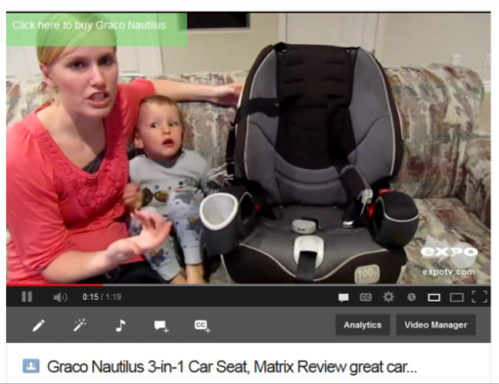
BEST PRACTICE for Video Publishing
PLACING VIDEO WHERE MOST SEARCH OCCURS
YouTube is the most powerful earned media channel in the world, helps ensure consumers can find the information that they are looking for when searching for your products.
EXPO Provides:
Automated publishing of brand approved, video to your brands YouTube channel (recommended over sourcing directly on YouTube)
The ability to in real-time commerce enable every video asset Optimization around metadata, ensuring your consumer video will surface in universal Google search
© 2013 EXPO Communications | Proprietary & Confidential
© 2013 John Courtney | Content Strategy Proprietary & Confidential

Slide 15
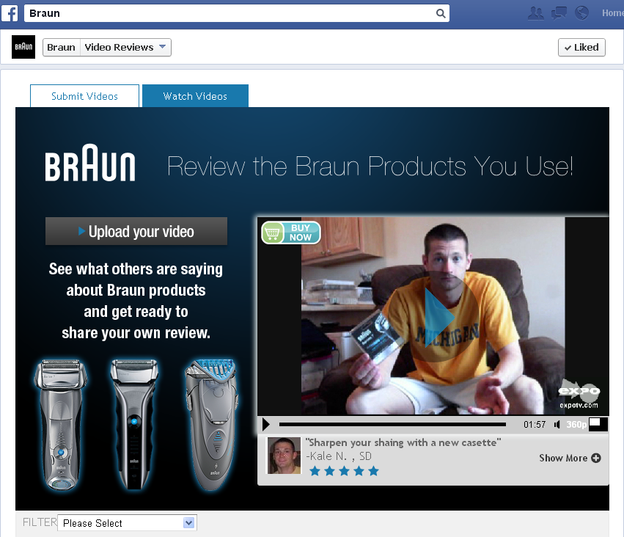
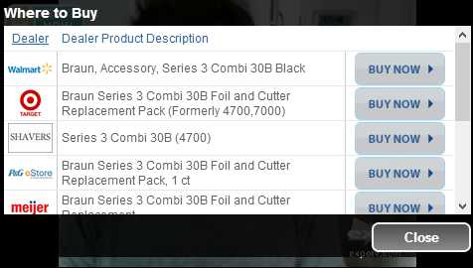
© 2013 John Courtney | Content Strategy Proprietary & Confidential

Slide 16
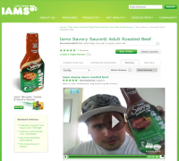
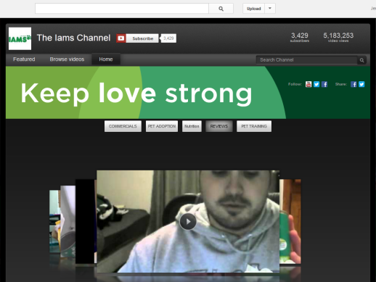
BEST PRACTICES for Retail Publishing
DRIVE ALL DIGITAL TOUCHPOINTS TO PURCHASE
Your digital presences captures shoppers throughout the purchase funnel. Enable all digital touch points with Buy It Now functionality to capture their intent with persuasive content.
EXPO Provides:
Channel Intelligence BIN Integration on each video on Facebook, brand site, YouTube
Additional custom links available on YouTube to drive to coupon, brand website, other engagement
Video-by-video conversion performance reporting (where EXPO player is used)
© 2013 EXPO Communications | Proprietary & Confidential
© 2013 John Courtney | Content Strategy Proprietary & Confidential

