Slide 1
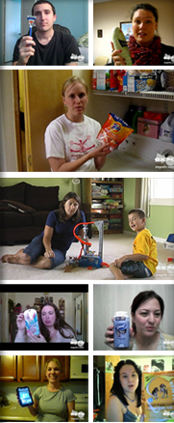
CROWD SOURCING
YOUR SHOPPING
MARKETING
CONTENT
© 2013 John Courtney | Content Strategy Proprietary & Confidential

Slide 2
Addressing your retail shelf used to be easier…
© 2013 John Courtney | Content Strategy Proprietary & Confidential

Slide 3
Search
Mobile
Retail
Need
Ad
Social
Purchase
Brand Site
© 2013 John Courtney | Content Strategy Proprietary & Confidential
Notes:
17 years later, Google published “Zero Moment of Truth” to describe the new impact on consumers at retail. The explosion of reaching the ‘click to buy’ moment is dizzying. Today’s shopper bounces back and forth at their own speed in a multi-channel marketplace. They can switch devices to suit their needs at any given moment. They search; go off to look at reviews, ratings, styles and prices; and then search again. They see ads on TV and in newspapers and online. They walk to local stores to look at products. They talk to friends, over the back fence and on social media.

