Slide 1
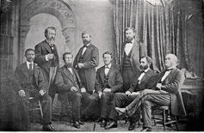
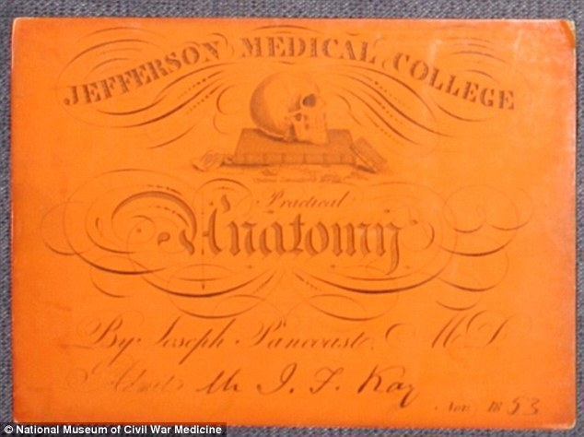

Slide 2
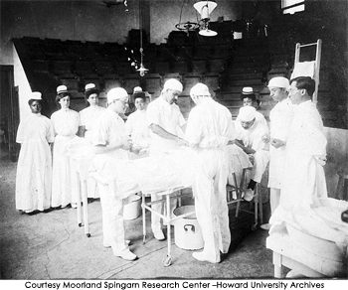
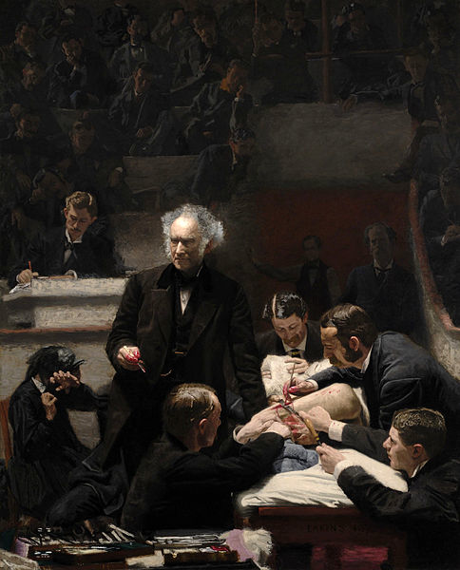
-FREEDMEN’S HOSPITAL CIRCA 1903
THE GROSS CLINIC
-THOMAS EAKINS 1875

Slide 3
“…PERSEVERANCE IS THE FOUNDATION OF ALL ACTIONS”
-LAO TSU

Slide 4
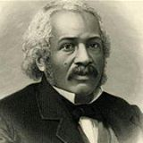
“The worst of our institutions, in its worst aspect, cannot keep down energy, truthfulness, and earnest struggle for the right.”
JAMES McCUNE SMITH

Slide 5
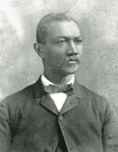
Lieutenant Colonel
Alexander T. Augusta
FREEDMEN’S HOSPITAL

Slide 7
“No individual has any right to come into the world and go out of it without leaving behind him distinct and legitimate reasons for having passed through.”
-George Washington Carver

Slide 8
SURGICAL EQUIPMENT-LATE 19TH CENTURY

Slide 9
IN 2010, 7.4% OF DOCTORAL DEGREES WERE
AWARDED TO AFRICAN AMERICANS. 65% OF THAT NUMBER WENT TO AFRICAN AMERICAN WOMEN
-NATIONAL CENTER FOR EDUCATION STATISTICS

Slide 10
“What is tolerance? It is the consequence of humanity. We are all formed of frailty and error; let us pardon reciprocally each other’s folly-that is the first law of nature.”
-VOLTAIRE

