Slide 1
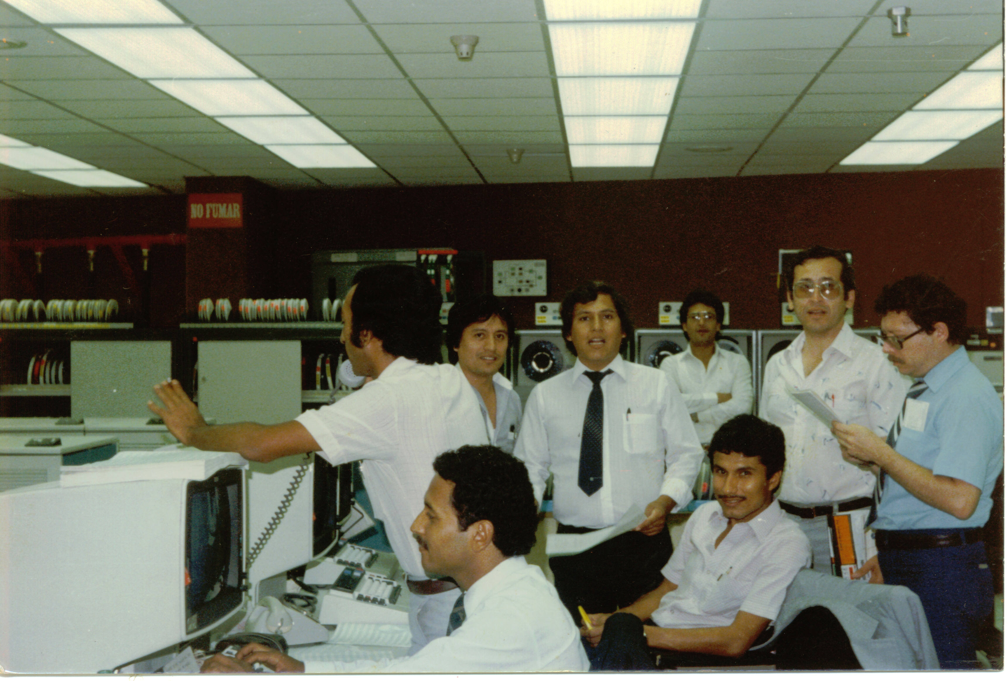
LUIS MARTINEZ: Senior Technology Executive with over 30 years experience in the IT field
Systems Administrator for IBM Mainframes in both Peru and the US
IT Manager IBM Corporation
IT Director – Carolee Designs
IT Director- Morrell and Company Wine and Liquor

Slide 2
NOTRE DAME HIGH SCHOOL I.T. DEPARTMENT PROGRESS
UPDATED-UPGRADED ALL COMPUTERS FOR STAFF AND FACULTY
UPGRADED NETWORK INFRASTRUCTURE
UPGRADED NETWORK WIRELESS SYSTEM
UPGRADED PHONE SYSTEM
UPGRADED CLASSROOM PROJECTORS
UPGRADED SCHOOL SERVER
UPGRADED TECHNOLOGY EQUIPMENT IN ARTS DEPARTMENT
UPGRADED EQUIPMENT IN OUR SKILL CENTER DEPARTMENT
UPGRADED INTERNET ACCESS AND INCREASED BACK UP TO SUPPORT ENTIRE SCHOOL INCLUDING ACCESS FOR ALL 600 NEW CHROMEBOOKS.

