Slide 1
“Who is he that condemned? It is Christ that died, yea rather, that is risen again, who is even at the right hand of God, who also make the intercession for us
-Romans 8:34

Slide 2
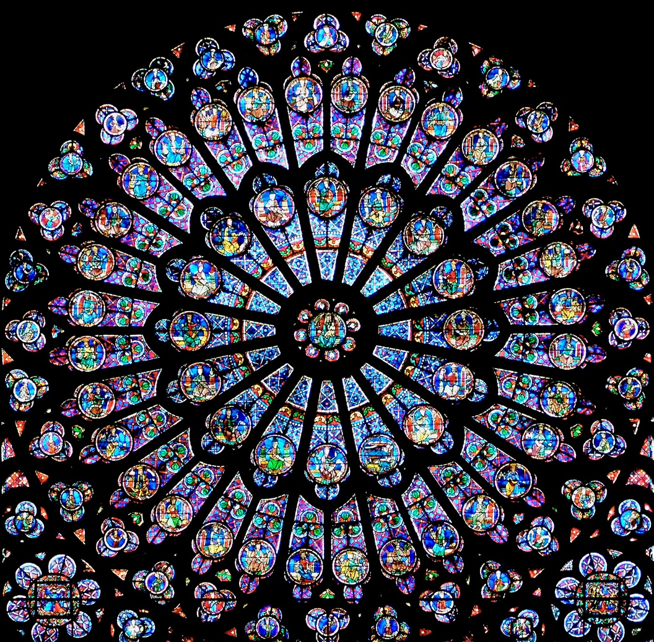
“People are like stained-glass windows. They sparkle and shine when the sun is out, but when the darkness sets in, their true beauty is revealed only if there is light from within.”
-Elizabeth Kübler-Ross

Slide 3
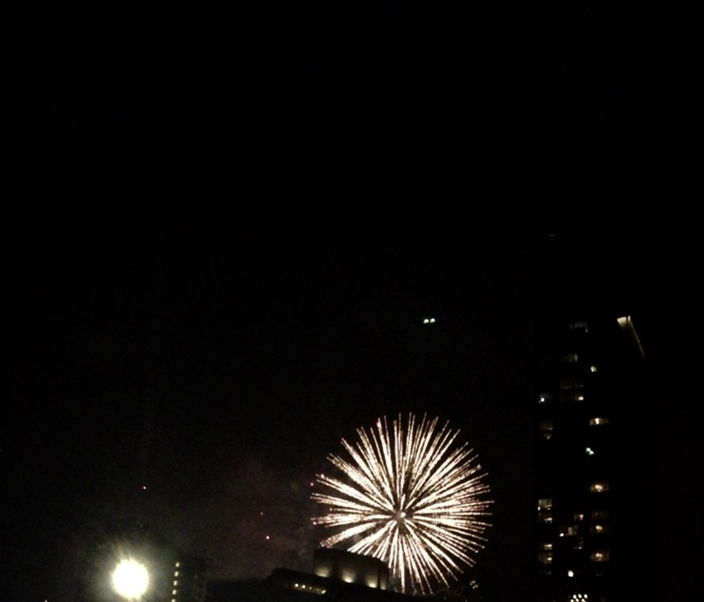
☑️ ACKNOWLEDGE yourself
☑️ Be INTERESTED and INTERESTING
☑️ Find MENTORS
☑️ Accept CONSTRUCTIVE CRITICISM
☑️ SELF GENERATE

Slide 4
“Who is he that condemned? It is Christ that died, yea rather, that is risen again, who is even at the right hand of God, who also make the intercession for us
-Romans 8:34

