Slide 1
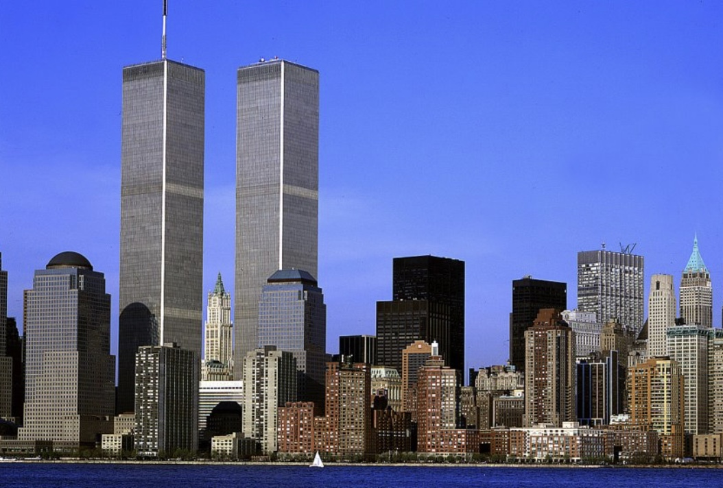

Slide 2
8:46 AM - 10:28 AM

Slide 3
SLIDE 3 WTC VIDEO

Slide 4
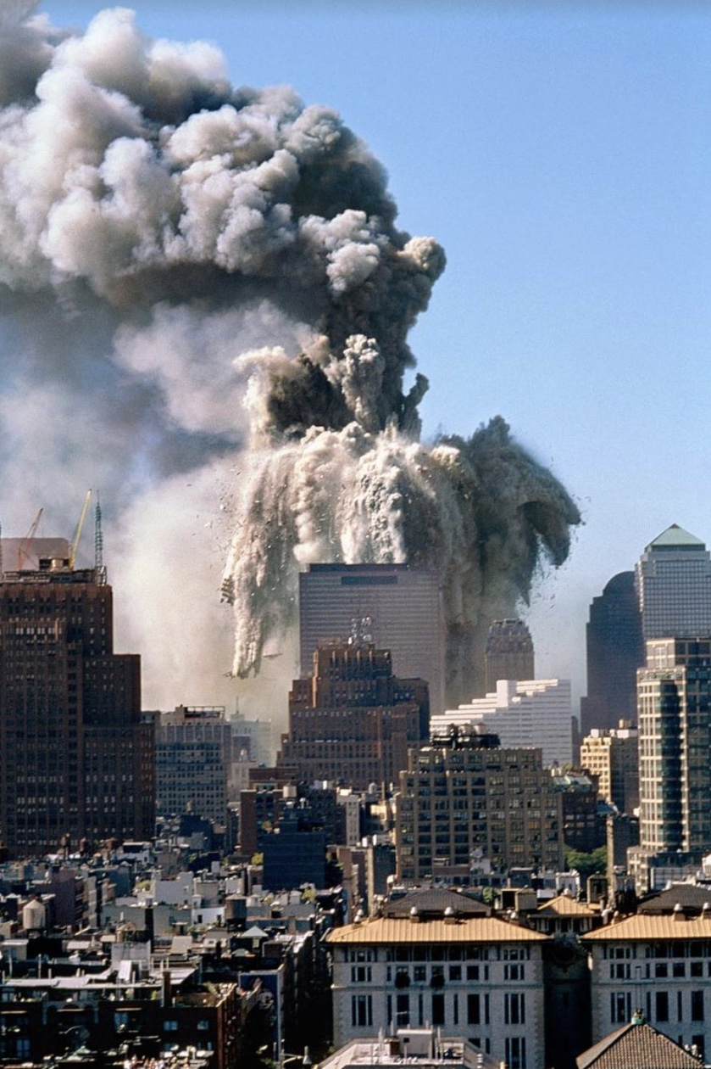
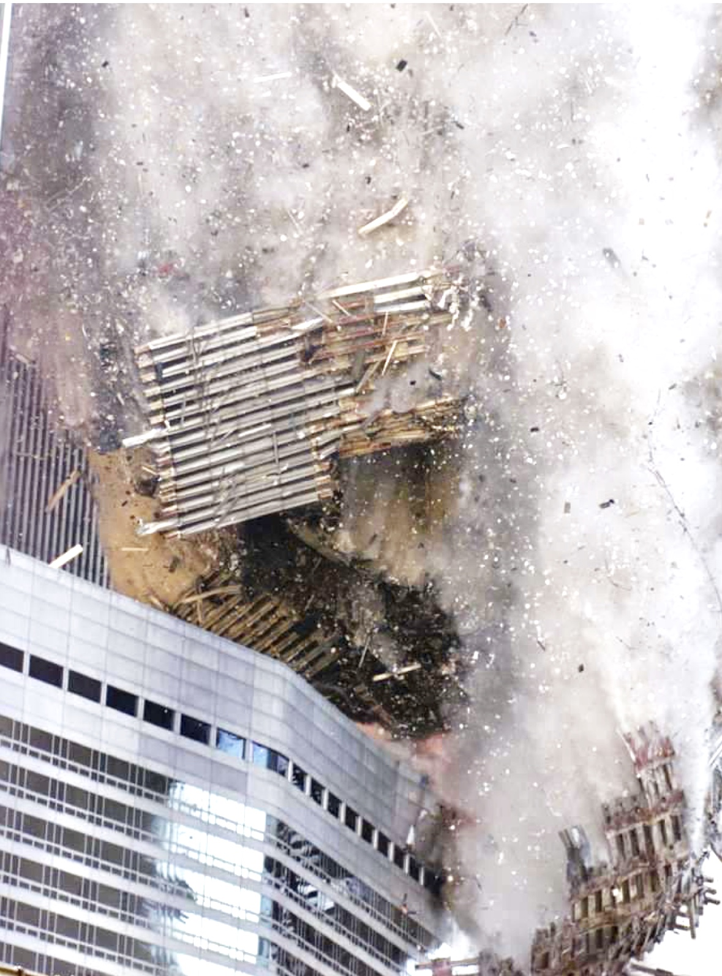

Slide 5
SLIDE 5 PENTAGON VIDEO

Slide 6
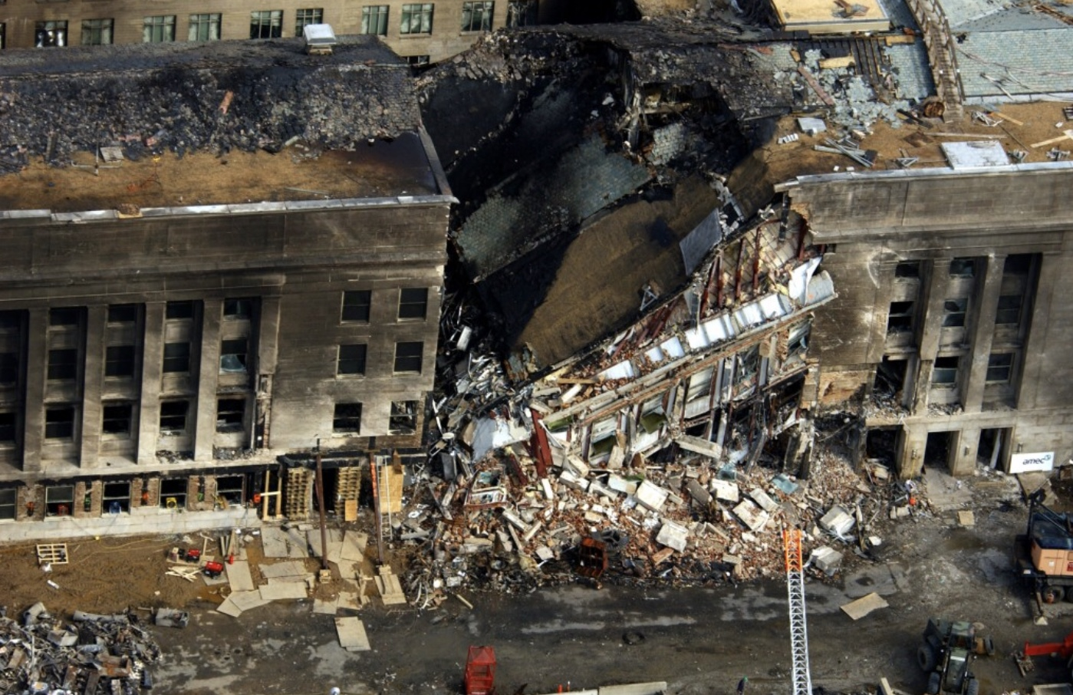
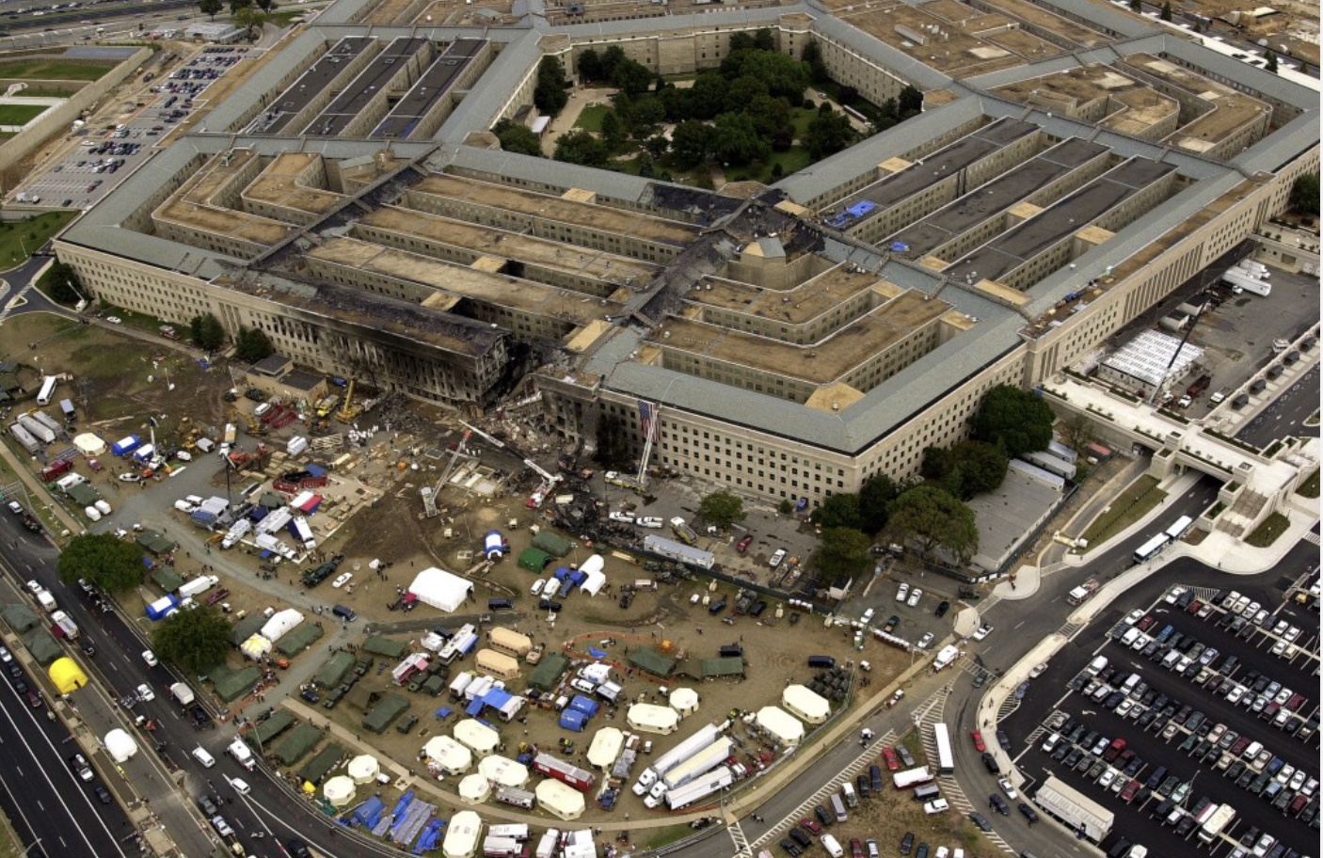
The Pentagon

Slide 7
“LET’S ROLL...”

Slide 8
SLIDE 8 PA VIDEO

Slide 9
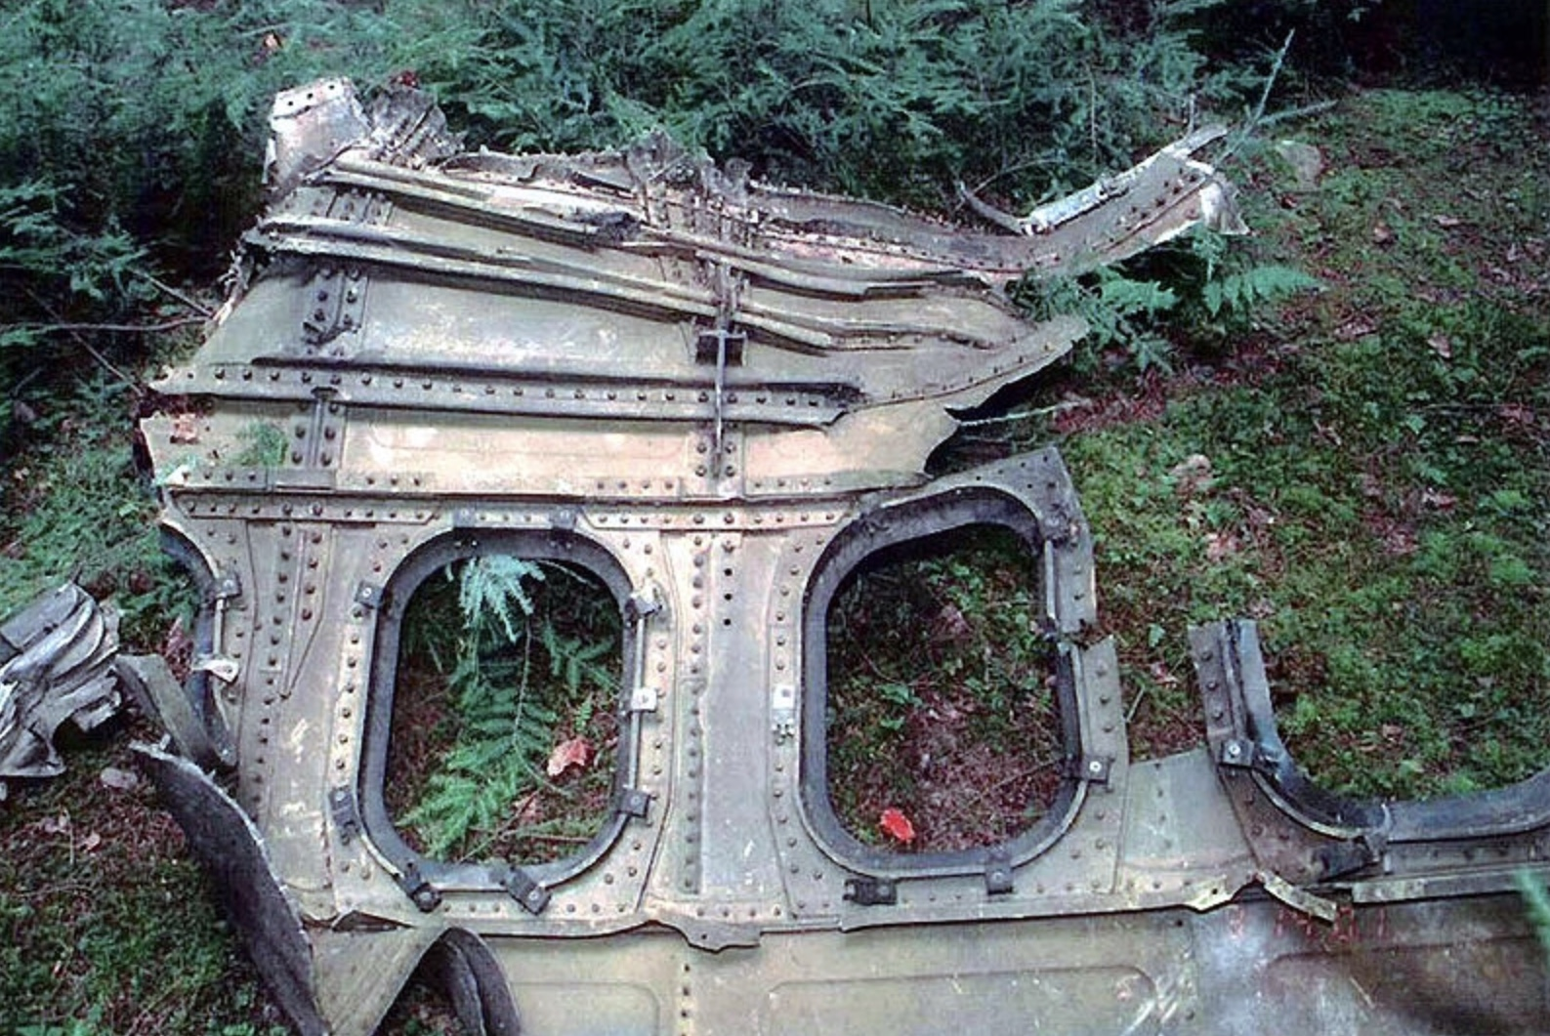
Somerset County, PA

Slide 10
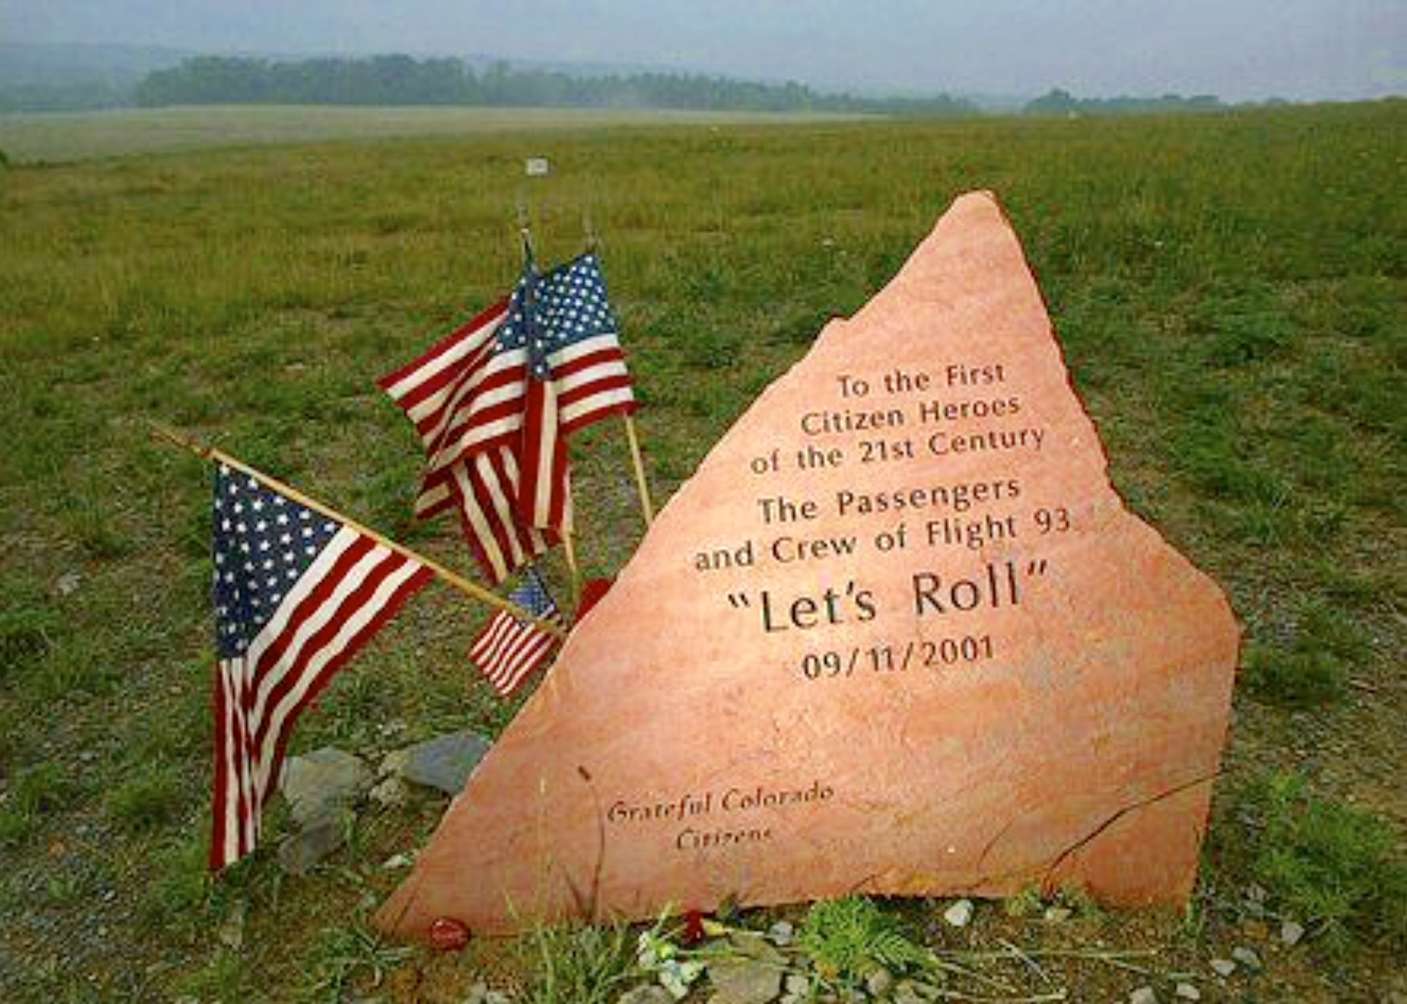
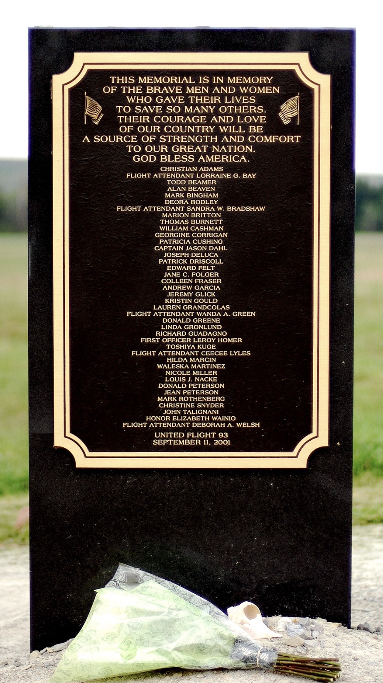

Slide 11
“I travel less and have safety in mind when I do...”
“We avoid big events more.”
“We have less trust in people who are different than us.”

Slide 13
“A house divided against itself cannot survive...”
-Abraham Lincoln

Slide 14
“...I do not expect the house to fall... I DO expect it will cease to be divided.”
-Abraham Lincoln

Slide 15
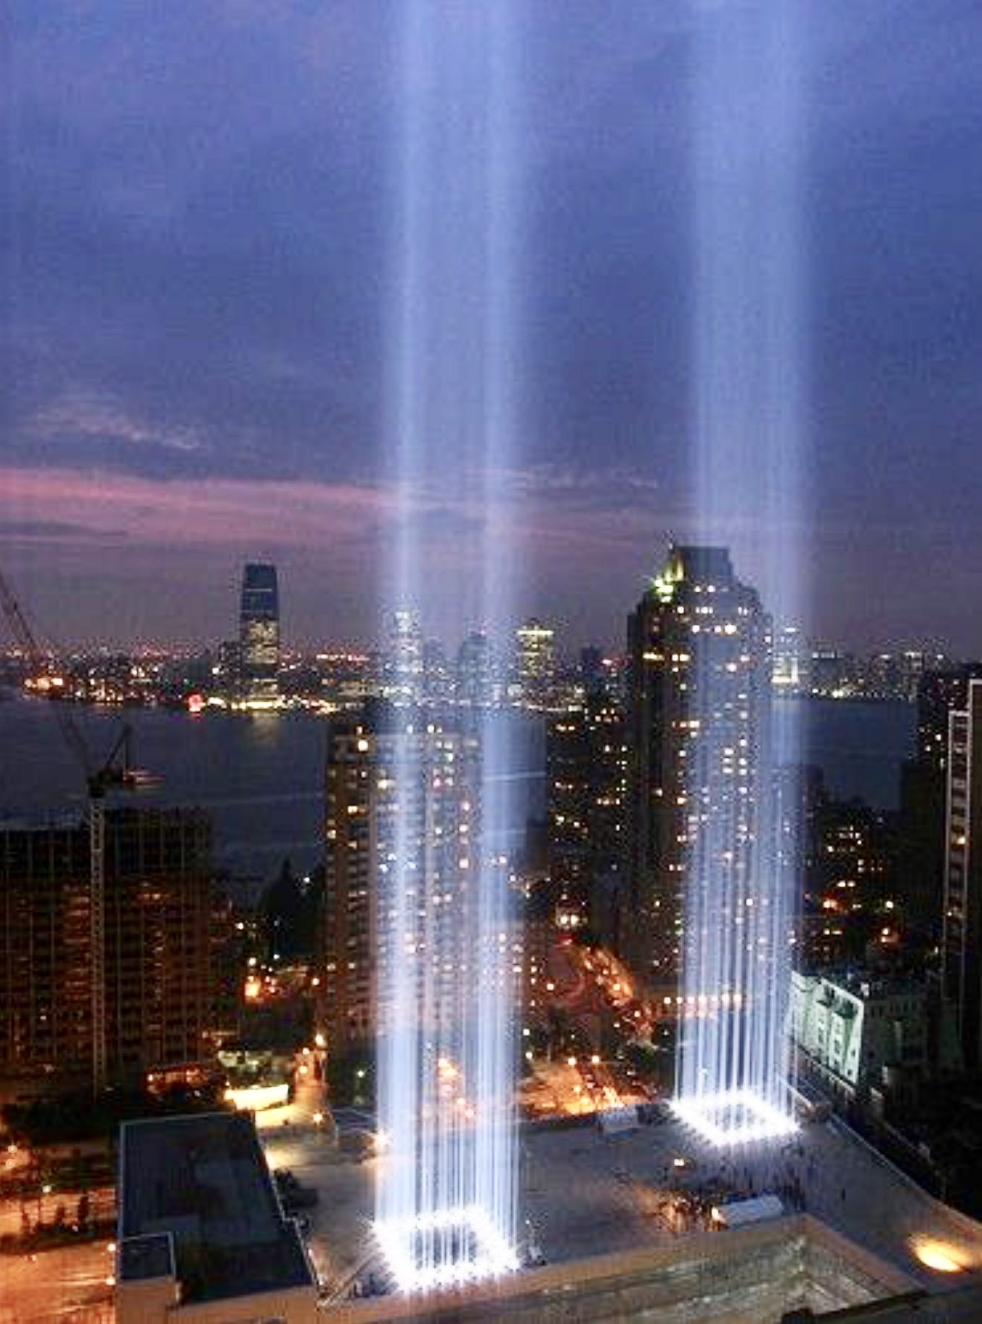
“What is essential is invisible to the eye.”
-Antoine de Saint- Exupery,
“The Little Prince”

Slide 16
“It’s not the honors and the visible trappings that ... nourish our souls...it’s the knowing we can be trusted, that we make a difference, that we never have to fear the truth....

Slide 17
That’s why love conquers hate, peace triumphs over war, and justice ultimately seeks to prevail.
...It’s that common sense of connection for which the human spirit yearns.
-Fred Rogers

Slide 18
“LET’S ROLL...”

