Slide 1
GLOBALIZATION 1.0…. Circa1492 DISCOVERY!!
GLOBALIZATION 2.0 …. Circa 1800… Industrial Revolution, Multi-National Companies
Globalization 3.0 circa 2000. The World goes from small to
……..tiny.
45 YEARS
STRONG

Slide 2
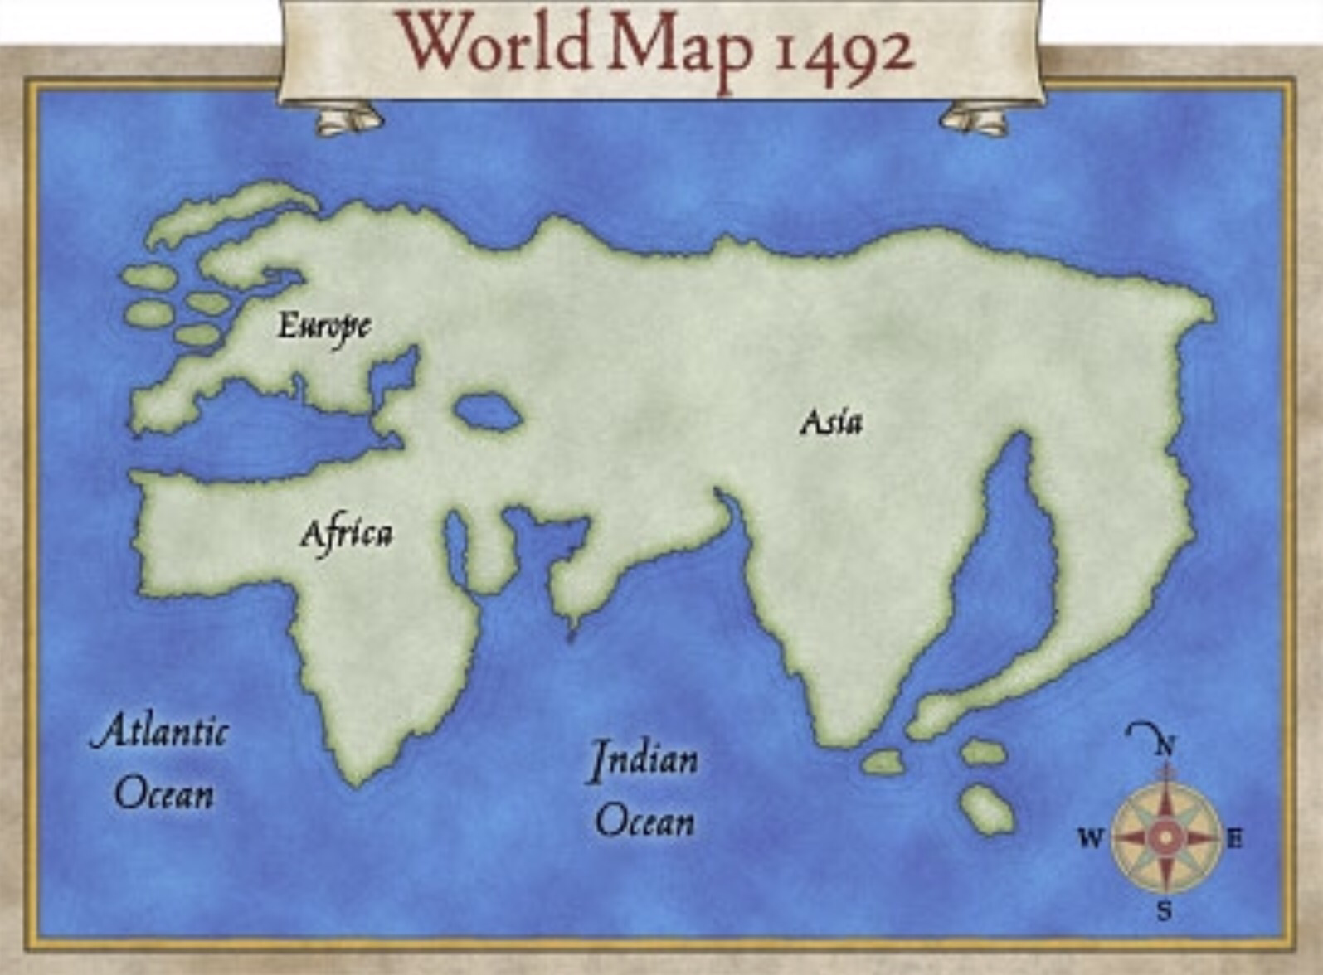
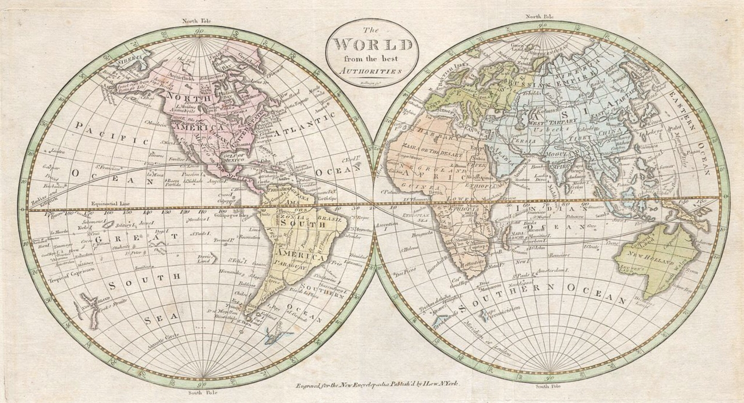
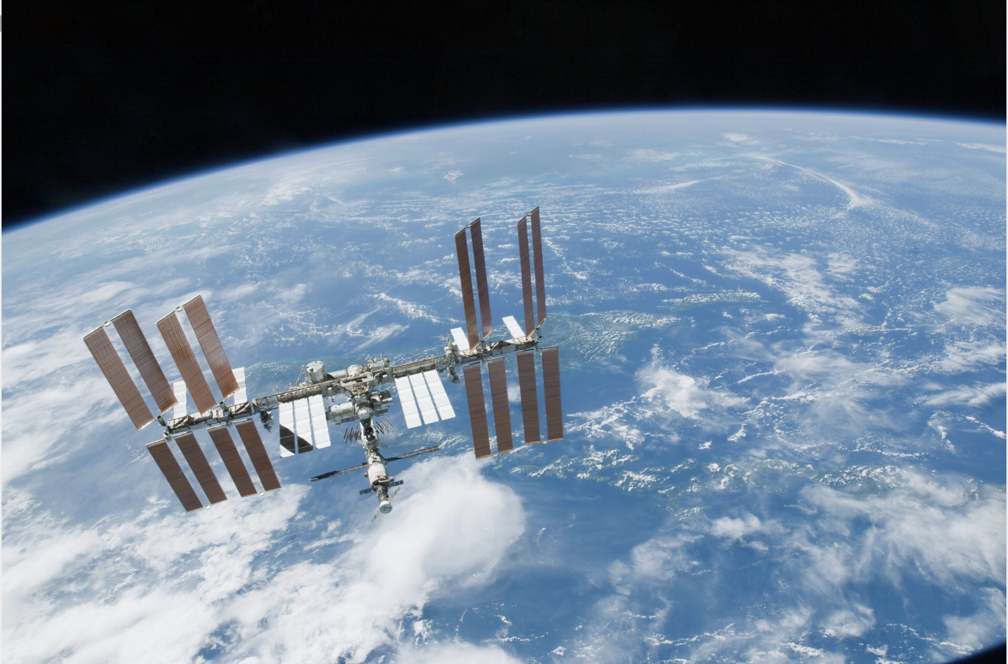
18th Century
2017 courtesy of ISS
45 YEARS
STRONG

Slide 3
“It is paradoxical, yet true, to say, that the more we know, the more ignorant we become in the absolute sense, for it is only through enlightenment that we become conscious of our limitations.
Precisely one of the most gratifying results of intellectual evolution is the continuous opening up of new and greater prospects.”
-Nikola Tesla
OR……
“I don’t know what I don’t know.”
-Anonymous
45 YEARS
STRONG

Slide 4
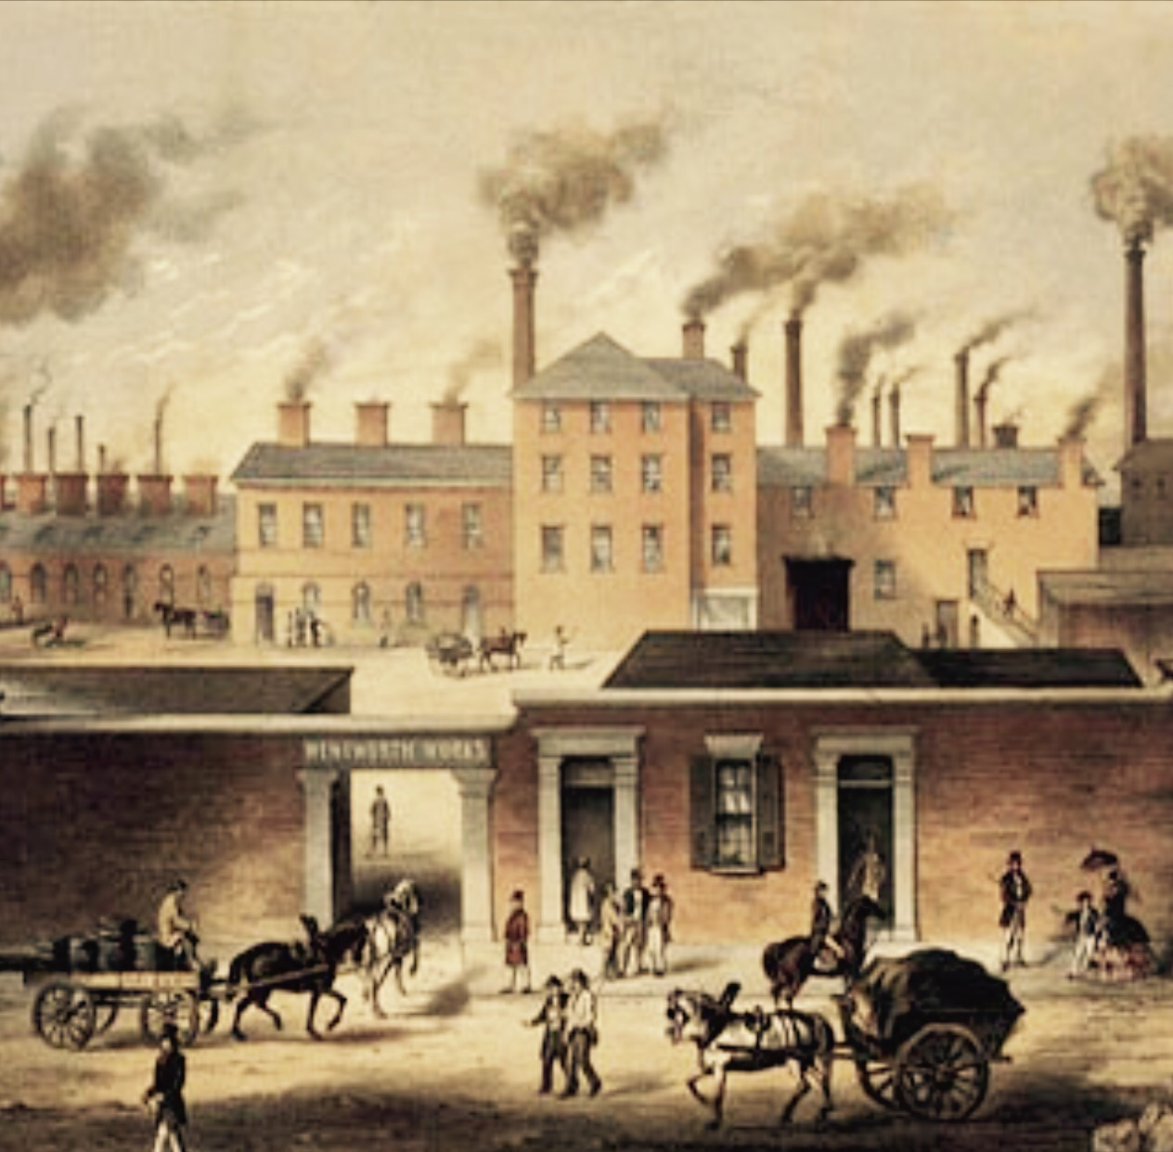
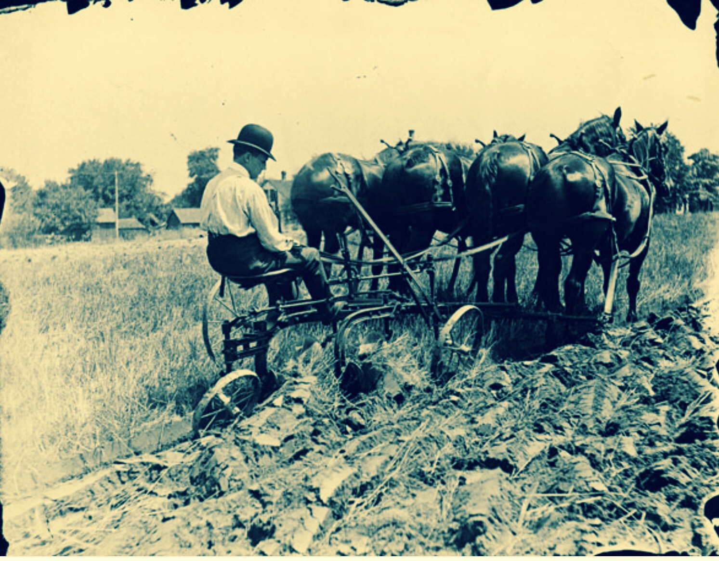
Agrarian Culture To Industrial Society

Slide 6
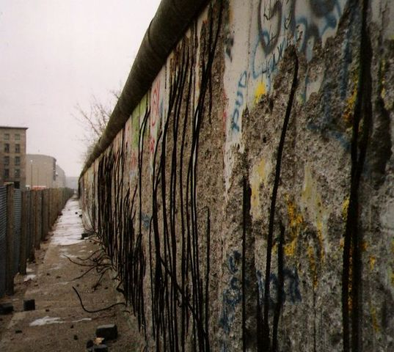
Berlin Wall When the walls fell down, the windows went up.
45 YEARS
STRONG

Slide 7
an·ti·glob·al·i·za·tion
ˌan(t)ēˌɡlōbələˈzāSH(ə)n,ˌanˌtīˌɡlōbələˈzāSH(ə)n/
EUROPEAN UNION
NAFTA
…….PROS AND CONS
45 YEARS
STRONG

Slide 8
CLINT PROTECTS
HIS NEIGHBORS…
45 YEARS
STRONG

Slide 9
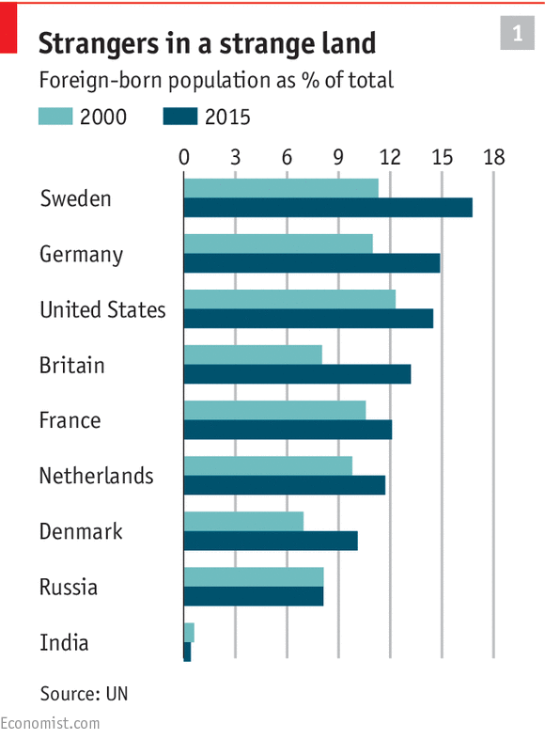
 | Force for good | Force for bad | Don't know
Britain | 46.0 | 19.0 | 36.0
Denmark | 68.1 | 14.8 | 17.1
Finland | 55.8 | 17.6 | 26.6
France | 36.7 | 37.4 | 25.9
Germany | 60.0 | 20.5 | 19.5
India | 83.0 | 7.2 | 9.9
United States | 40.0 | 27.4 | 32.6
Vietnam | 91.4 | 3.5 | 5.1
World Opinion About Globalization
45 YEARS
STRONG

Slide 10
“IT HAS BEEN SAID THAT ARGUING ABOUT GLOBALIZATION IS LIKE ARGUING AGAINST THE LAWS OF GRAVITY.”
-Kofi Annan
45 YEARS
STRONG

Slide 11
Thank You !
I am Mark Salvatore
You can find me at marksalvatore@sunshinet.com
45 YEARS
STRONG

