Slide 2
A “ Local Age “ in a Global World
How technology and marketing can create a direct connection

Slide 3
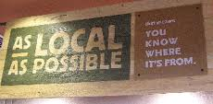
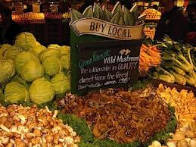
Local vs Locale
Local - image of buy local

Slide 4
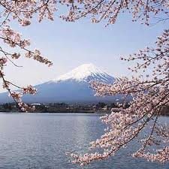
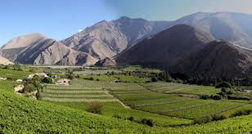
Local vs. Locale
Locale - insert images

Slide 5
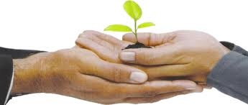
A solution for ???
For technology and marketing to support a solution we need to take a moment to understand what we are trying to solve !

Slide 6
Consumers
I need someone to help me make a more informed purchase decision
I need to balance finding healthy food for my family and my financial limitations
I don’t’ always shop the same way –help me make quick decisions when my needs change

Slide 7
Retailers
I have multiple ways to communicate with customers
Weekly ads
Media support for mailers
Labor costs – training staff
Effective “ in-store “ – the face behind the food

Slide 8
Retailers
Demonstrate that I have have good produce relative to the competition ( local & variety )
Respond to personalized shopping provided by on line retailers
Comply with traceability laws and food safety concerns

Slide 9
Growers
Want access to customers – tell “ my “ story “
An outlet for all that I grow ( size / quality )
Need to comply with traceability laws and food safety concerns.

Slide 10
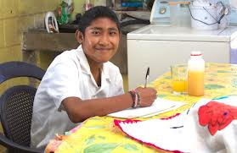
Trending now…
Community Support Agriculture – create a global community in your produce dept.
Fair Trade

Slide 11
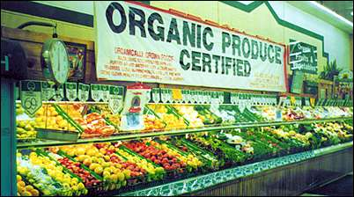
Trending now…
Organics

Slide 12
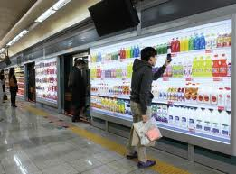
Trending now…
Digital shopping

Slide 13
Trending now …
Know your grower is a popular theme on supplier web sites ..
BCHH image www.bchothouse.com/grower-vandermeulen.html
Jazz Apple – Hamish Rush image-www.jazzapple.co.nz/our-growers/hamish-rush-tasman-fruitpackers/
Oppy – our growers – image –oppy.com
Sumo Citrus - meet out growers – image sumocitrus.com/meet_our_growers.html

Slide 14
Know your grower Web Sites
Beautiful photo’s, compelling stories but does it really connect with consumers ?
Can we make the information available at the point of purchase ?
How can time starved retailers take advantage of it ?

Slide 15
Making the consumer connection
BAA code ( insert image ) http://baacode-cache.icebreaker.com/catalog08/images/baacode/shared/baacode_header.jpg

Slide 16
Making the consumer connection
Dole Earth http://www.dole.eu/dole-earth/
( add image )
best quote ever in a press release – This engaging and emotional experience is as close as possible to a real farm tour. After completing it, consumers will certainly take a very different look at their banana “

Slide 17
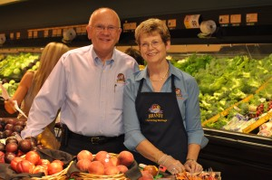
Connecting “ in store “
Meet the Growers – Harmons – Brandt Farms Insert image- www.harmonsgrocery.com/blog/2012/07/meet-the-growers-brandt-farms/

Slide 18
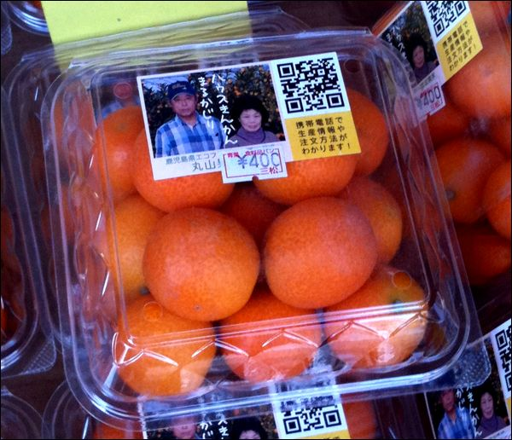
Connecting “ in store “
QR Codes – Japan Kumquats
Insert web site ? http://2d-code.co.uk/fresh-produce-qr-code/

Slide 19
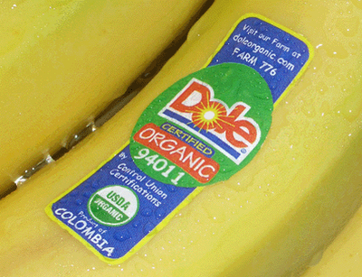
Connecting “ in store “
Green Scans
Insert images www.greenscans.com
Plu Stickers
Insert image of Dole organic banana

Slide 20
Brand your Recipes
Recipe Bridge
Insert image ( http:// www.recipebridge.com )

Slide 21
Social Media

Slide 22
Mobile Marketing

Slide 23
Global Community Supported Agriculture
What if …
There was a digital platform that could be accessed by growers, marketers and sellers ?
And could be used to train staff ?
Celebrate “ show rooming “ with in-store, QR codes, Mobile scanning applications

Slide 25
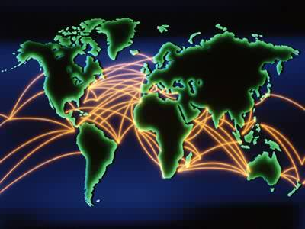
Local vs Locale
Make the connection

Slide 26
Thank you for your time.

Slide 27
GET IN TOUCH WITH DAWN FOR A FRESH DIRECTION ON…
BUSINESS STRATEGY
CHANGE MANAGEMENT
BUSINESS DEVELOPMENT
GROWER RELATIONS / SUPPLY SOURCING
SUCCESSFUL PRODUCT STRATEGIES
MARKETING, BRANDING, PACKAGING

