Slide 1
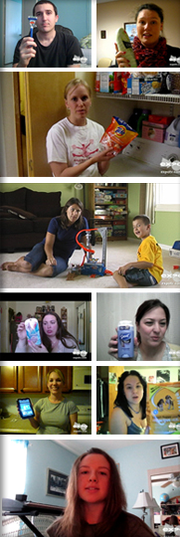
Crowdsourcing your
Shopping Marketing
Content
Notes:
First off, I would like to thank MediaPost for the opportunity to present in front of you today {I would like to add a little humor here for ice breaker…”maybe my last time presenting if I suck”}. I would like to spend my time with you discussing how leveraging social channels to engage and acquire crowd source content can directly benefit the top line. The unprecedented convergence of the global economic recession and the explosion in technology really has caused buyers to change how they interact with brands. No longer do they see advertising and then show up at the store wanting to learn more. Now, after consumers hear about you, their next step is to learn more (and look for the best price) when they open their laptops, pickup their smartphones or grab their tablets, and search to see if you meet their needs. They may read a review, look for a coupon, watch a video, or read a blog or social network discussion of your brand. We are officially living in a post-information asymmetry world. No longer is tipping the balance in favor of the seller.

Slide 2
Addressing your retail shelf used to be easier…
Notes:
17 years ago Proctor & Gamble coined the phrase “first moment of truth (FMOT)”. Considered the most important marketing opportunity for a brand FMOT basically says “shoppers make up their mind about a product in three to seven seconds, just the time it takes to note a product on a store shelf”. Dissecting this further; the first FMOT is when a browser first encounters a product in the store (they win if the customer decides to purchase). The second moment of truth happens each time a customer uses the product. So for P&G, each time somebody washes a load of laundry with Tide, feeds their dog Iams, or brushes their teeth with Crest is another marketing opportunity. Or, as they say in their 2002 Chairman's Address, "The second moment of truth occurs two billion times a day when consumers use P&G brands. Every usage experience is our chance to delight consumers." Just a little fun fact, around same time P&G coined FMOT, a little bookseller started selling online {Amazon}.

Slide 3
Search
Mobile
Retail
Need
Ad
Social
Purchase
Brand Site
Notes:
17 years later, Google published “Zero Moment of Truth” to describe the new impact on consumers at retail. The explosion of reaching the ‘click to buy’ moment is dizzying. Today’s shopper bounces back and forth at their own speed in a multi-channel marketplace. They can switch devices to suit their needs at any given moment. They search; go off to look at reviews, ratings, styles and prices; and then search again. They see ads on TV and in newspapers and online. They walk to local stores to look at products. They talk to friends, over the back fence and on social media.

Slide 4
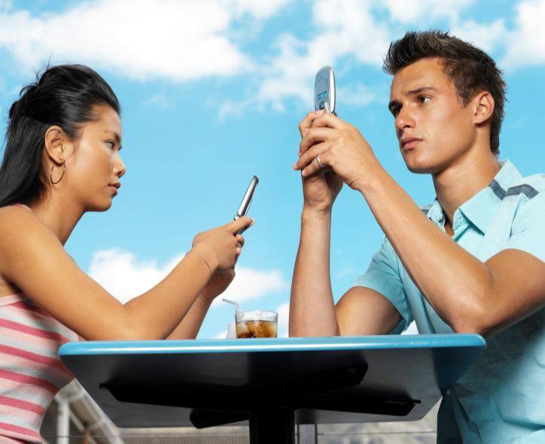
How can you
create messaging
everywhere she is?
Notes:
So now shopper Marketing has become a term that can now mean every consumer touch point offline or online. Google says “80% of success in the ZMOT is just showing up.” But how can you create enough relevant content to show up everywhere when the average shopper is looking at 8 different sources across owned, retail and social channels?

Slide 5
1 in 4 consumers post about you or to you
Source: US only; comScore, Pew
Notes:
Activating consumers can help you solve your content needs. They can create a great amount of content cost effectively and persuasively. In fact, 1 in four are doing it already, we call them the Brand Connected Consumer. These are consumers who are filling the web with conversations around your brands. They want to connect with brands, they want to be part of the conversation. 70-80% of them believe you see what they’ve posted and that you value what they say.

Slide 6
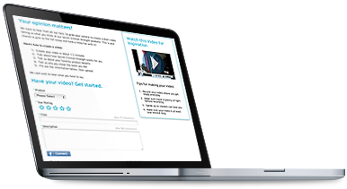
CAPTURING VALUABLE CONTENT
WHEREVER THEY ARE.
Notes:
The changes in consumer needs, perceptions and expectations driving the use of social media, when in turning are dictating future trends in customer relationship management, are social, not business or technological – and these are irreversible. Customers have been empowered. They have taken control of the conversation, whether brands like it or not, and they are not going to give it back. Social customer relationship management is about customer engagement, not management, and marketers must embrace this philosophy and reflect this in the customer experiences they deliver and actions they enable via social media.

Slide 7
Leveraging User Generated & Professional Content
A platform built on years of social video experience
Relevant, informative, persuasive video content on product-page level
Sears has partnered with EXPO for past three years to build a library of over 33,000 user generated videos for Sears & Kmart products generated from social/communities such as Facebook, YouTube and Mobile
Drawing on EXPO’s 8 years of video community management with over 150,000 consumers, and a platform managing 350,000 product videos, Sears continues to add new user generated videos everyday
EXPO’s best-in-class online video platform powers all professional and user generated video supporting millions of SKUs and hundreds of merchants
EXPO adheres to legal and corporate best practices including moderation standards, consumer response needs and performance requirements.
Notes:
Approximately three years ago Sears partnered with EXPO to integrate & match EXPO’s user generated video content library to the Sears & Kmart product catalogs which today have grown to approximately 33,000 user-generated videos across 12,000+ products. Leveraging social networks such as Facebook, YouTube and Mobile properties has allowed Sears to scale very quickly.

Slide 8
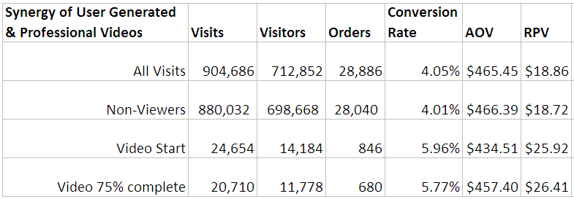
Critical Question
How does crowdsourced user-generated videos offer value?
Notes:
At Sears, a critical question: ‘how do user-generated videos complement professionally-produced content, if at all.’ What we found was strong evidence of incremental benefit with exposure to both forms of media. In the campaign examined, professionally-produced content and product videos drove strikingly higher lifts when used together. Initial test results suggest that even greater returns can be had by combining their use with authentic, user-generated content.

Slide 9
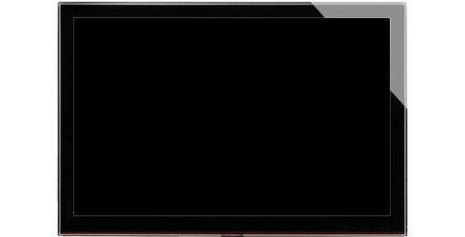
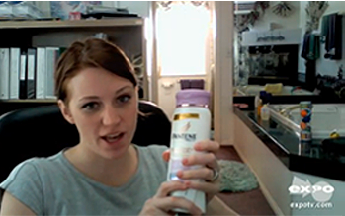
Crowdsourcing User-Generated Product Videos
Consumers persuaded by Professional video
Consumers persuaded by User video
User-Gen Reviews
Competitive Comparison
Product Quality
Product Convenience
New Feature Information
Professional Video
Emotional Elements
Brand Differences
Superiority Claims
2.7% Overlap
comScore April 2012 study comparing “Lift in Share” sourced by professionally produced video and user product review.
Notes:
It seems that professionally-produced content and user-generated product videos are each successful at delivering different key elements to customers through video ‘advertising’.” We found that customers perceived feature benefits as more believable when coming directly from the brand through professionally-produced content, while the unbiased user-generated videos were more believable in verifying specific product claims, such as superiority and convenience. When used together, all of the perceived gaps get filled in and consumers become more confident in their purchase decision, resulting in better sales effectiveness from the advertising.

Slide 10
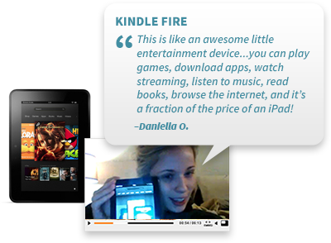
CROWDSOURCING
IT’S TOUGH, BUT IT CAN BE DONE
3,000:1
Ratio of
Text vs. Video
Notes:
Find them where they are used to talking with you…
Typical expo response
Right approach, and how it translates in other environments

Slide 11
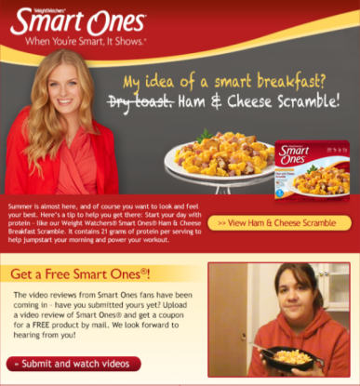
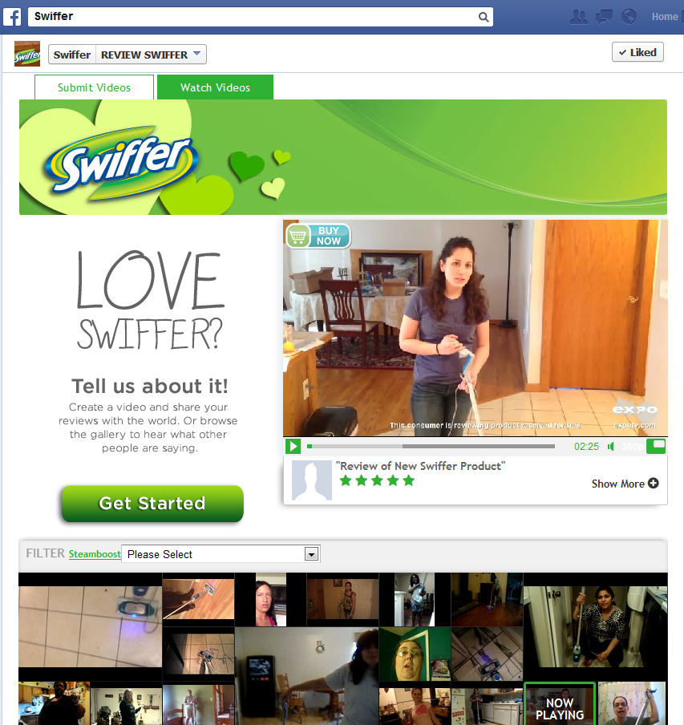
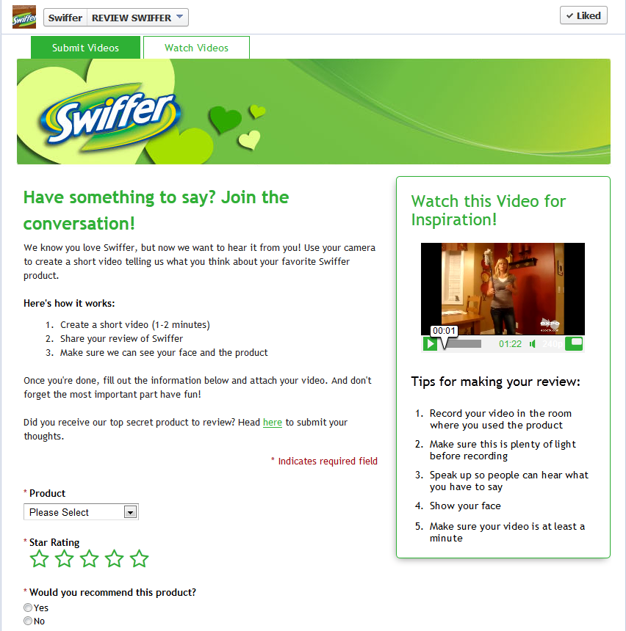
CROWDSOURCING
ACTIVATING COMMUNITIES TO CONTRIBUTE
There are a few important, yet overlooked steps when looking to generate quality video content from consumers:
Target the right consumers
Provide proper incentives
Model desired behavior
Give instructions
Notes:
The second major difference from professional is the authenticity of the message created by real consumers. On a more apples to apples comparison we tested longer form professional how-to against an unedited user-generated how-to for the same product. The authenticity, and the ability for consumers to know what’s important led to an unedited how to by a consumer to outstrip the interest level from a scripted, edited, professionally produced how to.

Slide 12
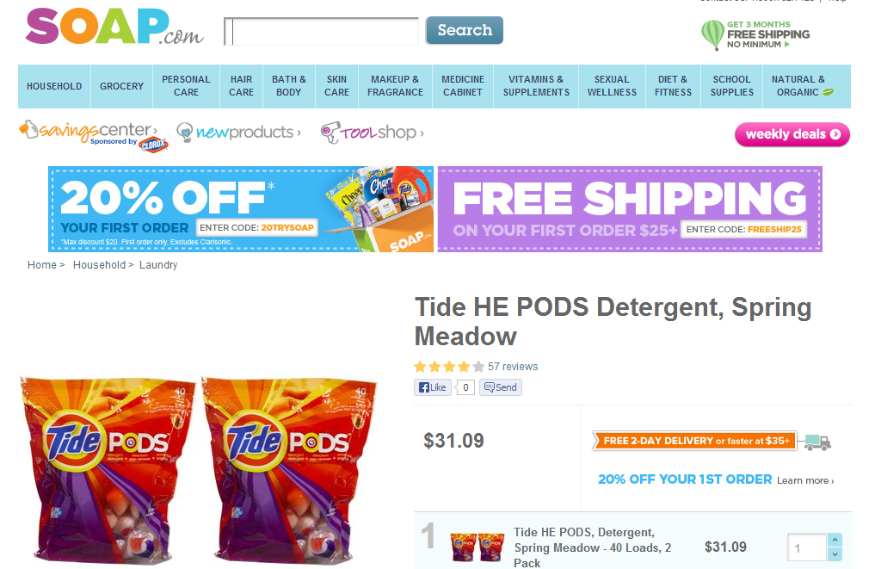
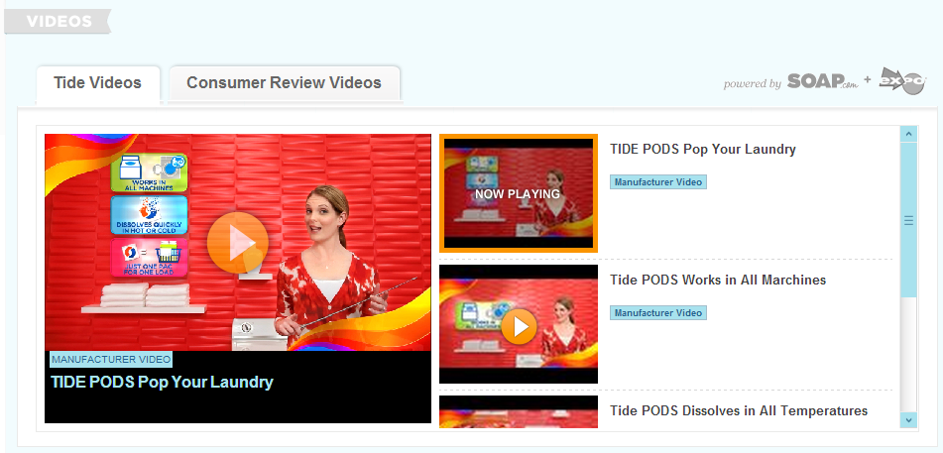
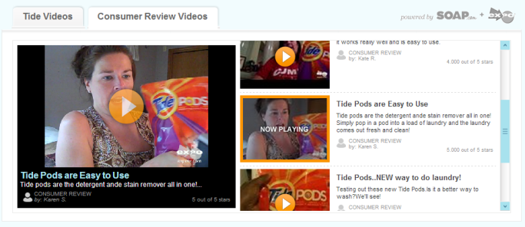
Best Practice: Pairing EXPO Video with professional video
A mix of EXPO video with professional video will reach the largest number of consumers with persuasive messaging.
Results:
EXPO video influences a distinctly separate consumer than professional videos (comScore)
Consumers will choose to watch EXPO videos 2-to-1 over professional videos when given a choice (internal EXPO)
80%+ retail consumers find EXPO videos easy to related to and believable (comScore)
Notes:
So how do you fill your digital shelf with this content? The great thing is that consumer content can be very flexible to fit the right shelf. Let’s start with the ZMOT at the online retailer product page. As you know each and every pixel is precious to them, and their testing is rigorous. In the hopes of the right content, to the right person at the right time, being able to create a choice helps consumers find the person most like them. In presenting user-gen content at the retail page, Quidsi elected to show as many as 9 thumbnails to be available on their product pages. We find that in a comparison, users will choose user video 2:1 over professional video when given a choice.
Quidsi is taking advantage of the fact that video viewers are 64% more likely to purchase, and wants to give them a broad range of choices to personalize their experience.

Slide 13
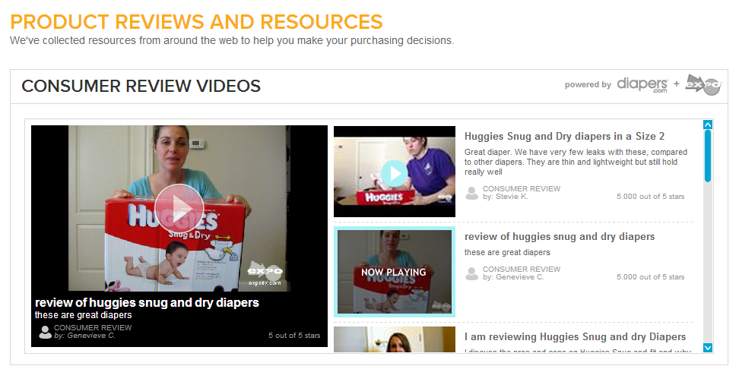
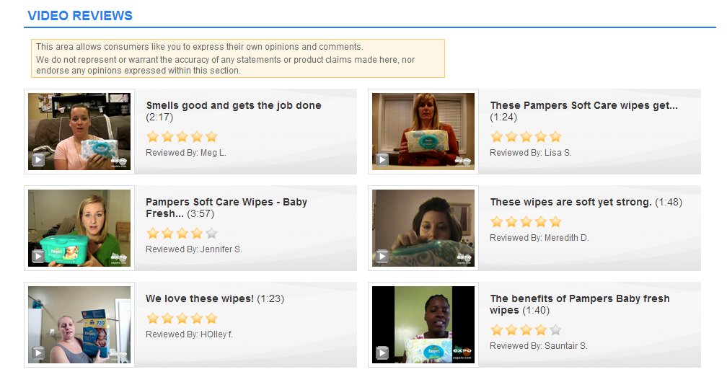
Best Practice: Availability of EXPO video on Product Pages
Present multiple thumbnails in-line on product pages so visitors can quickly identify with “someone like me”
Scrolling
Fixed Display
“Gallery”
comScore A/B Test:
+13% higher desire to pay more for a product
+26% higher belief that the product is unique and different
Example 1: diapers.com
Example 2: P&G eStore
Notes:
The second major difference from professional is the authenticity of the message created by real consumers. On a more apples to apples comparison we tested longer form professional how-to against an unedited user-generated how-to for the same product. The authenticity, and the ability for consumers to know what’s important led to an unedited how to by a consumer to outstrip the interest level from a scripted, edited, professionally produced how to.

Slide 14
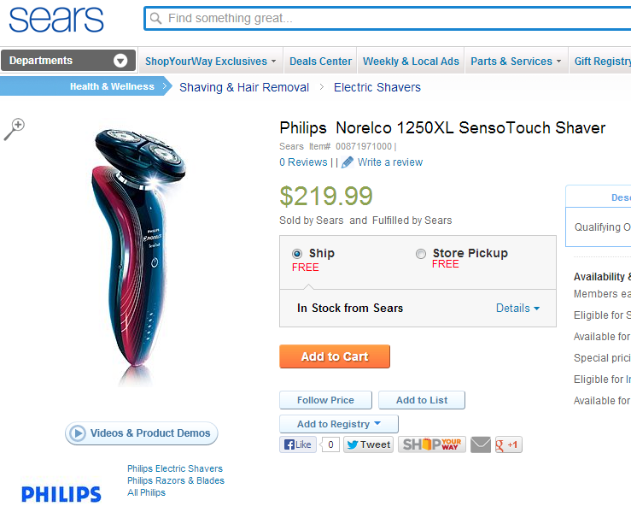
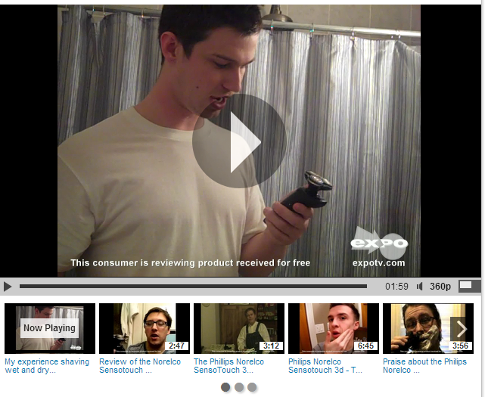
Impact of EXPO Video Viewership on Retail Websites
EXPO video widget integrated onto product pages of major national brick and mortar retailer websites
Results:
5.1x higher conversion of visitors who watched EXPO video
66% higher cart size for visitors who watched EXPO video
Notes:
The second major difference from professional is the authenticity of the message created by real consumers. On a more apples to apples comparison we tested longer form professional how-to against an unedited user-generated how-to for the same product. The authenticity, and the ability for consumers to know what’s important led to an unedited how to by a consumer to outstrip the interest level from a scripted, edited, professionally produced how to.

Slide 15
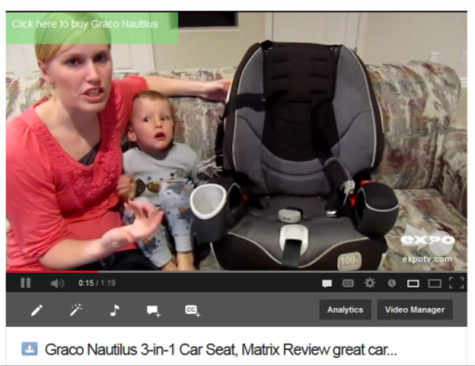
BEST PRACTICE for Video Publishing
PLACING VIDEO WHERE MOST SEARCH OCCURS
YouTube is the most powerful earned media channel in the world, helps ensure consumers can find the information that they are looking for when searching for your products.
EXPO Provides:
Automated publishing of brand approved, video to your brands YouTube channel (recommended over sourcing directly on YouTube)
The ability to in real-time commerce enable every video asset Optimization around metadata, ensuring your consumer video will surface in universal Google search
© 2013 EXPO Communications | Proprietary & Confidential
Notes:
Google is 56x more likely to rank video content on the first SERP than text content (Forrester)
OR
Youtube is the #2 largest search engine

Slide 16
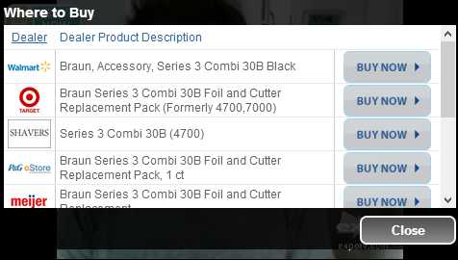
Notes:
And although you might not buy anything now from Facebook, it has recently surpassed google as the #1 place people spend time online. Again, when they’re on your content, turning it into a retail shelf can only be a help. In fact, EXPO has seen higher click to buy activity on Facebook than on manufacturer sites.

Slide 17
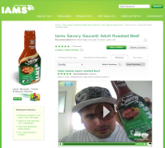
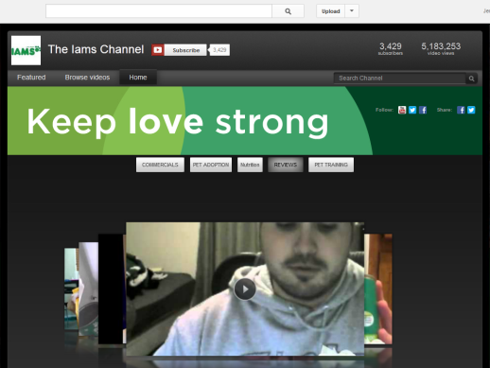
BEST PRACTICES for Retail Publishing
DRIVE ALL DIGITAL TOUCHPOINTS TO PURCHASE
Your digital presences captures shoppers throughout the purchase funnel. Enable all digital touch points with Buy It Now functionality to capture their intent with persuasive content.
EXPO Provides:
Channel Intelligence BIN Integration on each video on Facebook, brand site, YouTube
Additional custom links available on YouTube to drive to coupon, brand website, other engagement
Video-by-video conversion performance reporting (where EXPO player is used)
© 2013 EXPO Communications | Proprietary & Confidential

