Slide 1


Pros & Cons of Globalization
I am Mark Salvatore
You can find me at marksalvatore@sunshinet.com
45 YEARS
STRONG
I am Mark Salvatore
You can find me at marksalvatore@sunshinet.com

Slide 2
History
45 YEARS
STRONG

Slide 3
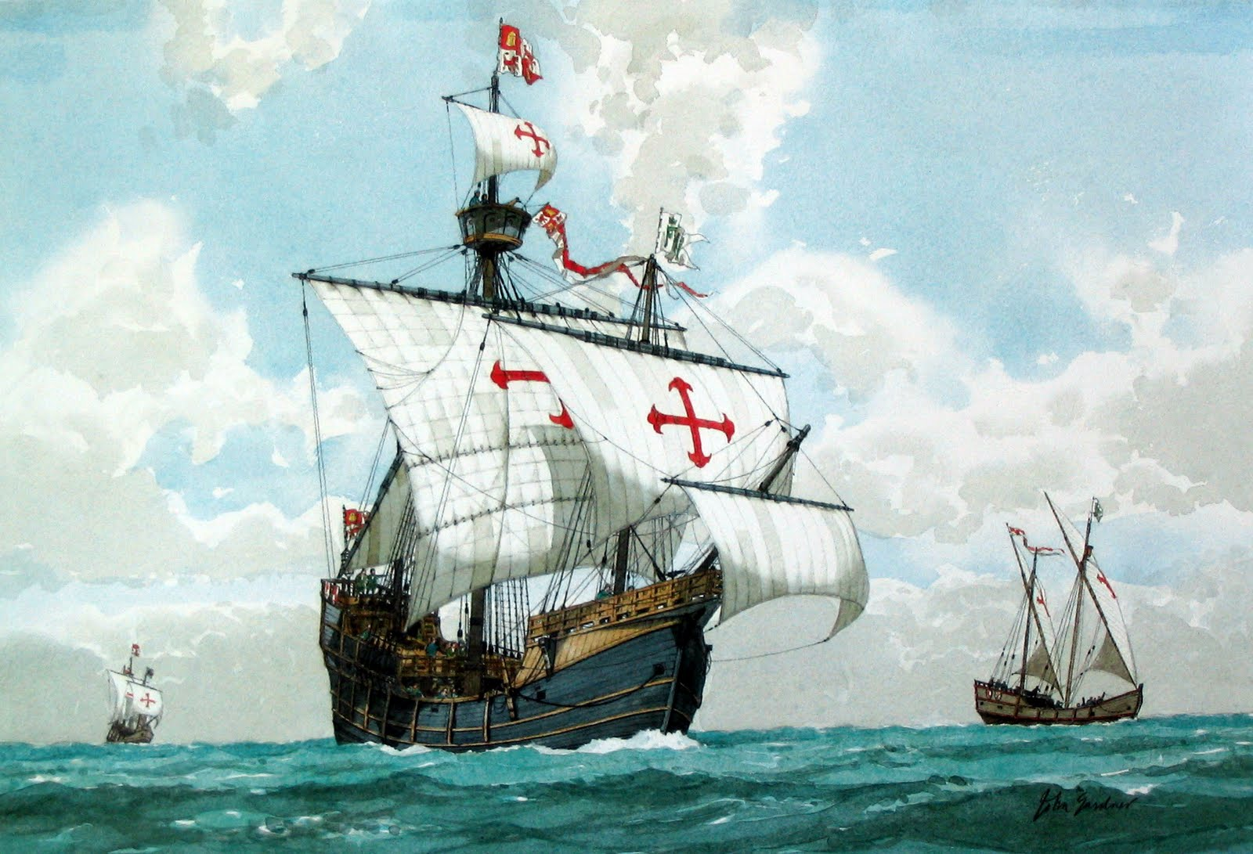
Start of major globalization
Discovery of North America
1492
45 YEARS
STRONG

Slide 4
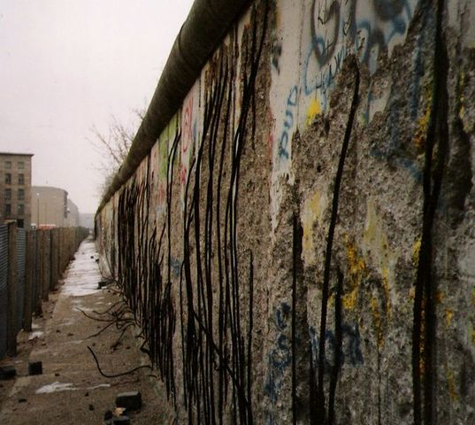
Berlin Wall
When the walls fell down, the windows went up.
45 YEARS
STRONG

Slide 5



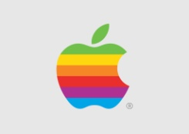




THE 8 MOST MEMORABLE LOGOS
16.0% 15.6% 11.1% 9.7% 2.9% 1.9% 1.5% 1.4%
Based on survey of 3,000 people to name the most recognizable brands. Siegel + Gale Co.

Slide 6
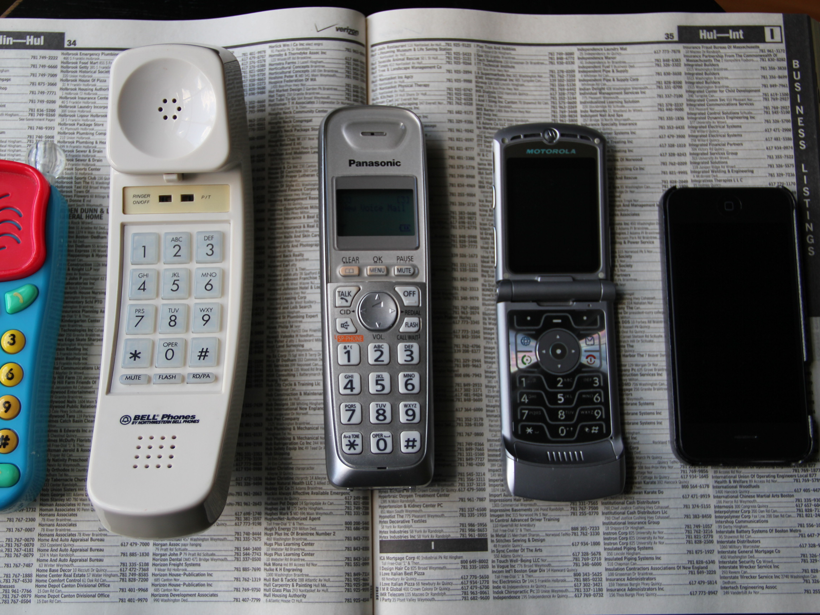
Globalization
3.0
Evolution of the cell phone
45 YEARS
STRONG

Slide 7
an·ti·glob·al·i·za·tion
ˌan(t)ēˌɡlōbələˈzāSH(ə)n,ˌanˌtīˌɡlōbələˈzāSH(ə)n/
45 YEARS
STRONG

Slide 8

Clint protects his neighbours
45 YEARS
STRONG

Slide 9
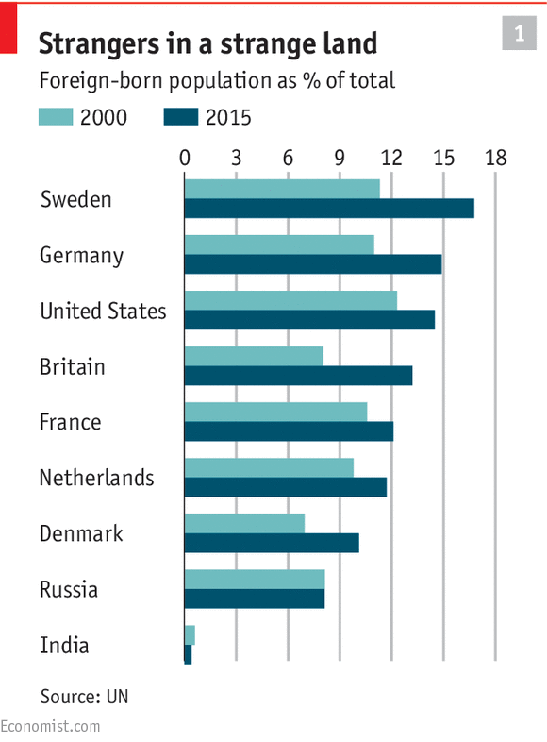
45 YEARS
STRONG

Slide 10
Overall, do you think Globalization is a force for good or bad for the world?
45 YEARS
STRONG

Slide 11
 | Force for good | Force for bad | Don't know
Britain | 46.0 | 19.0 | 36.0
Denmark | 68.1 | 14.8 | 17.1
Finland | 55.8 | 17.6 | 26.6
France | 36.7 | 37.4 | 25.9
Germany | 60.0 | 20.5 | 19.5
India | 83.0 | 7.2 | 9.9
United States | 40.0 | 27.4 | 32.6
Vietnam | 91.4 | 3.5 | 5.1
World Opinions about Globalization
45 YEARS
STRONG

Slide 12
?
We must protect our borders from the ravages of other countries making our products, stealing our companies, and destroying our jobs. Protection will lead to great prosperity and strength
—Donald J. Trump, Inaugural Address
45 YEARS
STRONG

Slide 13
45 YEARS
STRONG

Slide 14
Thanks!
Any questions?
You can find me at marksalvatore@sunshinet.com
45 YEARS
STRONG

Slide 15
Credits
Special thanks to all the people who made and released these awesome resources for free:
Presentation template by
Logo Chart from FORTUNE MAGAZINE – June 15,2017
Photograph by 2008 Warner Bros. Entertainment
45 YEARS
STRONG

