Slide 1
National Security Through Responsible Information Sharing
Kshemendra Paul
Program Manager, Information Sharing Environment
April 2014

Slide 2
Vision
National security through responsible information sharing
Mission
Advance responsible information sharing to further counterterrorism and homeland security, and cybersecurity missions
Improve nationwide decision making by transforming information ownership to stewardship
Promote partnerships across federal, state, local, and tribal governments, the private sector, and internationally

Slide 3
Scope
International
Private Sector
Tribal
Mission Partners
Classified Information
Terrorism
WMD
Homeland Security
Cyber
Local
…
State
Federal
Law Enforcement
Frontline
Investigators
Analysts
Operators
Defense
Information
Sharing Environment
(ISE)
Intelligence
Communities
Homeland Security
Diplomacy
Information Technology Industry

Slide 4
PM-ISE Differentiators
We are an honest broker.
We have existing tools and initiatives.
We do transparent planning and evaluation.
Notes:
These are the intangible assets that we have at PM-ISE.
We coordinate, we monitor. We do not oversee.

Slide 5
Nationwide Challenges
Multiple Missions & Authorities
Crushing Financial Pressures
Evolving & Converging threats
National Approaches to Interoperability
Integrated Capabilities & Shared Services
Common Operating Models
300+ million
People
77 Fusion Centers
6 RISS Centers
28 HITDAs
80,000
Agencies
750,000+
Officers
FBI
CJIS ▫ FIGs ▫ JTTFs ▫ JRIGs
250,000
911 Operators
DHS
I&A ▫ ICE ▫ CBP ▫ DNDO ▫ NPPD
1.2 million
Firefighters
DOJ
ATF ▫ DEA ▫ OJP
Nlets
2.2 million
Security Officers
NCTC ITACG
Maritime Domain
Air Domain
18 CI/KR Sectors
DoD
NORTHCOM
* Numbers are estimates
Protection of Privacy, Civil Rights, and Civil Liberties

Slide 6
Accelerating Responsible Cybersecurity Information Sharing
Supporting FSLT Integration and Unity of Effort
Enhancing Shared Situational Awareness (CNCI #5)
Leveraging ISE Management Tools & Frameworks
Notes:
These are the intangible assets that we have at PM-ISE.
We coordinate, we monitor. We do not oversee.

Slide 7
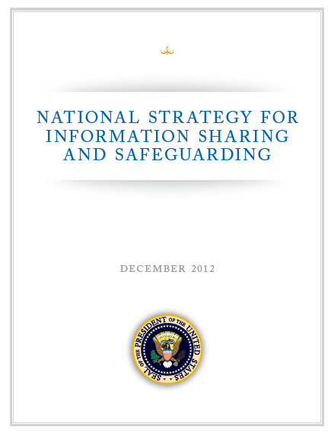
National Strategy
Principles:
Information as a national asset.
Information sharing and safeguarding requires shared risk management.
Information informs decision making.

Slide 8
Priority Objectives
Governance
Agreements
Data Tagging
FICAM
Safeguarding
Interoperability Baseline Capabilities
Training
Discovery & Access
Private Sector Sharing
DA Reference Architecture
Shared Services
Standards-based Acquisition
Foreign Partners
RFI Process
NSI
Fusion Centers
8

Slide 9
Institutionalizing a Management Framework
Strategic Implementation Plan
ISE Management Plan
Detailed Planning and Implementation Guidance
Performance-Based Oversight

Slide 10
Project Interoperability
Discover Capability or Managed Service
Build New Capability
Extend Existing Capability
Modular Development
Discover
Interoperable Services
Build
Interoperable Services
Extend
Interoperable
Services
Repeatable Integrated Continuum

Slide 11
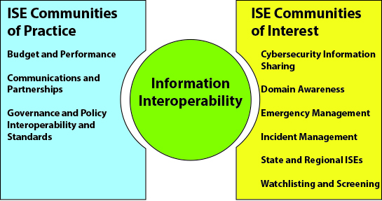
ISE CoP and CoI

Slide 12
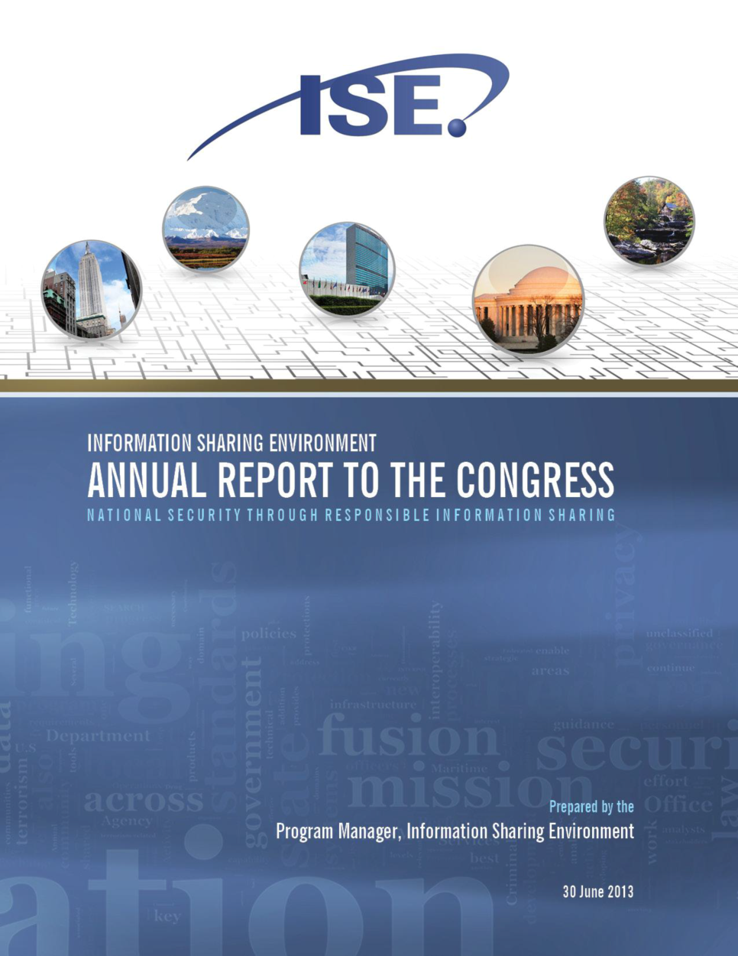
ANNUAL REPORT TO THE CONGRESS
Our Annual Report Card – Emphasizing Mission Partner Success
Inventory of tools, frameworks, & Initiatives making up the ISE
Best Practices & Lessons Learned
Indentified Opportunities for Reuse & Leverage
Available on www.ise.gov

Slide 13
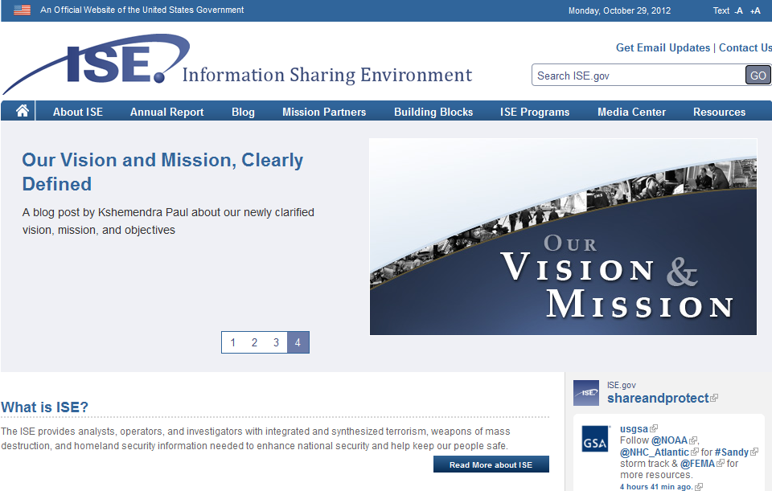
Visit ISE.gov
@shareandprotect

