Slide 1
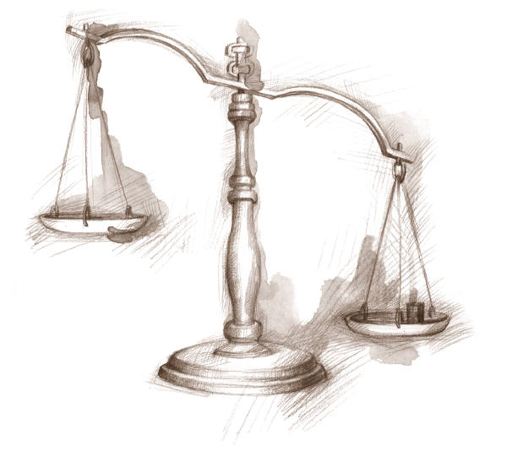
Racial Disparity in the Criminal Justice System in the United States
Presented by: Stephen R. Reed, Paralegal/Legal Assistant

Slide 2
Radical Disparity In the Judicial System
What does it mean to the fabric of a community and family to have such a
substantial portion of its young men enmeshed in the criminal justice system?
What is the effect on a community’s political influence when one quarter of the
black community in some states cannot vote as a result of a felony conviction?
What images and values are communicated to young people who see prison as
The most prominent influence role model in the community?
There are indeed many causes of racial disparity, and it just isn’t include the
judicial system, but culturally, such as the military, and various local city or
state police departments.

Slide 3
Racial Disparity in the Criminal Justice System
Brief History of the problem
It has always been that racial disparity exists when the proportion of racial/ethnic
group within the control of the system is greater than the population of such groups
in the general population.
Research indicates that there are two fundamental causes of racial disparity. First,
disproportionate crime rates, where a series conducted over the past thirty years
has examined the degrees to which disproportionate rates of incarceration for Afro-
Americana are related to greater involvement in crime.

Slide 4
Racial disparity in the criminal justice system
Causes
The first major cause of racial disparity is the “fear of the other”. Fear
appears to be a natural phobia (social phobia irrational anxiety elicited by
exposure to certain types of social or performance situations, also leading to
avoidance behavior.
Fear of the Unknown, or the other is common place and goes back to the
earliest stories of humankind (Fox., E.R.MD, Fear of the Unknown,
Western Journal of Medicine, (1987 Jun; 146-759-760).
The second cause of racial disparity, and the one that determines so much of
the unbalance within our judicial system, is the need for superiority over
others. The need to feel that there are better ways of doing, being, thinking,
and the way “we do it all is better that is why we do things this way.

Slide 5
Racial disparity in the judicial system in
Effects
In the judicial system, there is a greater tendency to give the blacks races harsher and
longer punishments.
Economically, the contributions of the blacks races are, outside of sports
entertainment, still far behind the white races.
Conclusion
The significant causes and their effects shows clearly the kinds of justice race generally
receives even though we try hard to be fair. Underneath, at a level we do not understand,
there appears to be a tendency to view “others” as inferior and even more dangerous,
indeed something to fear.

Slide 6
references
Franklin, C., Waukeehon, J., Larney, P.S., Timmer, D.F., Pennekamp, M. (1995). Indian
Gordon, R., Piana, L.D., & Keleher, T. (2000). Facing the Consequences: An examination of racial discrimination
in U. S. Public schools. ERASE Imitative, 1-32.
Griffith, K. G. & Kristsonis, W.A. (2007). The achievement gap between African-Americans and non-minority
students: How can we close the gap? The Lamar University Journal of Student Research, 1-5.
Hosp, J. L., & Resechly, D. J. (2004) Disproportionate representation of minority students in special education:
Academic, demographic, and economic predators. Council for Exceptional Children, 70, 185-199.

